Slide 2
Contents
Abstract……………………………………………………………………………………………………………….
Introduction…………………………………………………………………………………………………………
Database Creation……………………………………………………………………………………………….
Data Collection……………………………………………………………………………………………….
Data Cleaning and Integration………………………………………………………………………..
Methodology: Multi-layer Model…………………………………………………………………………
Layer 1: Ground Level Object Identification…………………………………………………….
Layer 2: Aerial Level Object Identification……………………………………………………….
Layer 3: Lane and Road Marking Identification……………………………………………….
Results…………………………………………………………………………………………………………………
5.1. Layer 1……………………………………………………………………………………………………..
5.2. Layer 2……………………………………………………………………………………………………..
5.3. Layer 3……………………………………………………………………………………………………..
Conclusion…………………………………………………………………………………………………………..
Acknowledgements.……………………………………………………………………………………………
References...………………………………………………………………………………………………………..
Appendices………………………………………………………………………………………………………….

Slide 3
Abstract
The World Bank encourages awareness of traffic and road safety incidents in its future projects. The Road Safety Screening and Appraisal Tool (RSSAT) helps to integrate these concerns into project investment studies, by proposing a quantitative approach to road safety assessment. With a comprehensive list of road attributes, the World Bank analysts can identify investment opportunities in safety enhancement.
Deep Learning would allow the efficient processing of large quantities of such data. The objective is to develop AI-based algorithms, leveraging purposefully trained Convolutional Neural Networks (CNN) for fast road attribute extraction from publicly available big data sources. This approach is particularly relevant in LMIC (Low and Middle-Income Countries) as it eliminates the need for costly data purchases or road video recordings.
Automating road feature detection would help the World Bank evaluate more projects, thereby increasing opportunities for expansion in LMICs.
1. Introduction
The World Bank's revised Environmental and Social Framework (ESF) now incorporates measures to address traffic and road safety issues. These standards require that all projects financed by the World Bank proactively avoid or mitigate potential road safety risks and their impacts. To facilitate the implementation of these measures, the World Bank has introduced the Road Safety Screening and Appraisal Tool (RSSAT). This guide provides detailed guidance to assess current road safety conditions divided in requirements categories. This study will focus on identifying relevant road variables such as: segment characteristics (physical median, pedestrian facilities, …), dominant roadside objects (safety barrier, posts, trees, …), intersection features, and pedestrian crossings.
In Low- and Middle-Income Countries (LMICs), road traffic accidents are a leading cause of death and serious injury. These countries often lack comprehensive road safety data and infrastructure, making the assessment and improvement of road safety a daunting task. Given the new standards from the World Bank, LMICs urgently need effective methods to identify and manage road safety risks.
Traditional road safety assessment methods are not only time-consuming and costly but also difficult to implement in the absence of adequate data. Particularly in LMICs, collecting comprehensive road attribute data requires significant time and resources, hindering the evaluation of the safety impact of road projects. To meet the new standards set by the World Bank, these countries need to find more efficient and economical ways to conduct road safety assessments.
The objective is to develop AI-based algorithms using purposefully trained CNNs to quickly extract road attributes from publicly available big data sources. The methodology used for the project consist of performing a data collection from specifically selected regions and countries via open-source datasets like: Open Image Dataset v7, Google Street View, CeyMo^{[1]} and Mapillary. The second phase consists in filtering and annotating the gathered pictures with the attributes the RSSAT needs. The use of one extensive model is limited by the versatility of objects’ shape to detect.
References
[1] Liu, X., Deng, Z., Lu, H., Cao, L.: Benchmark for road marking detection: Dataset specification and performance baseline. In: 2017 IEEE 20th International Conference on Intelligent Transportation Systems (ITSC). pp. 1–6. IEEE (2017)

Slide 4
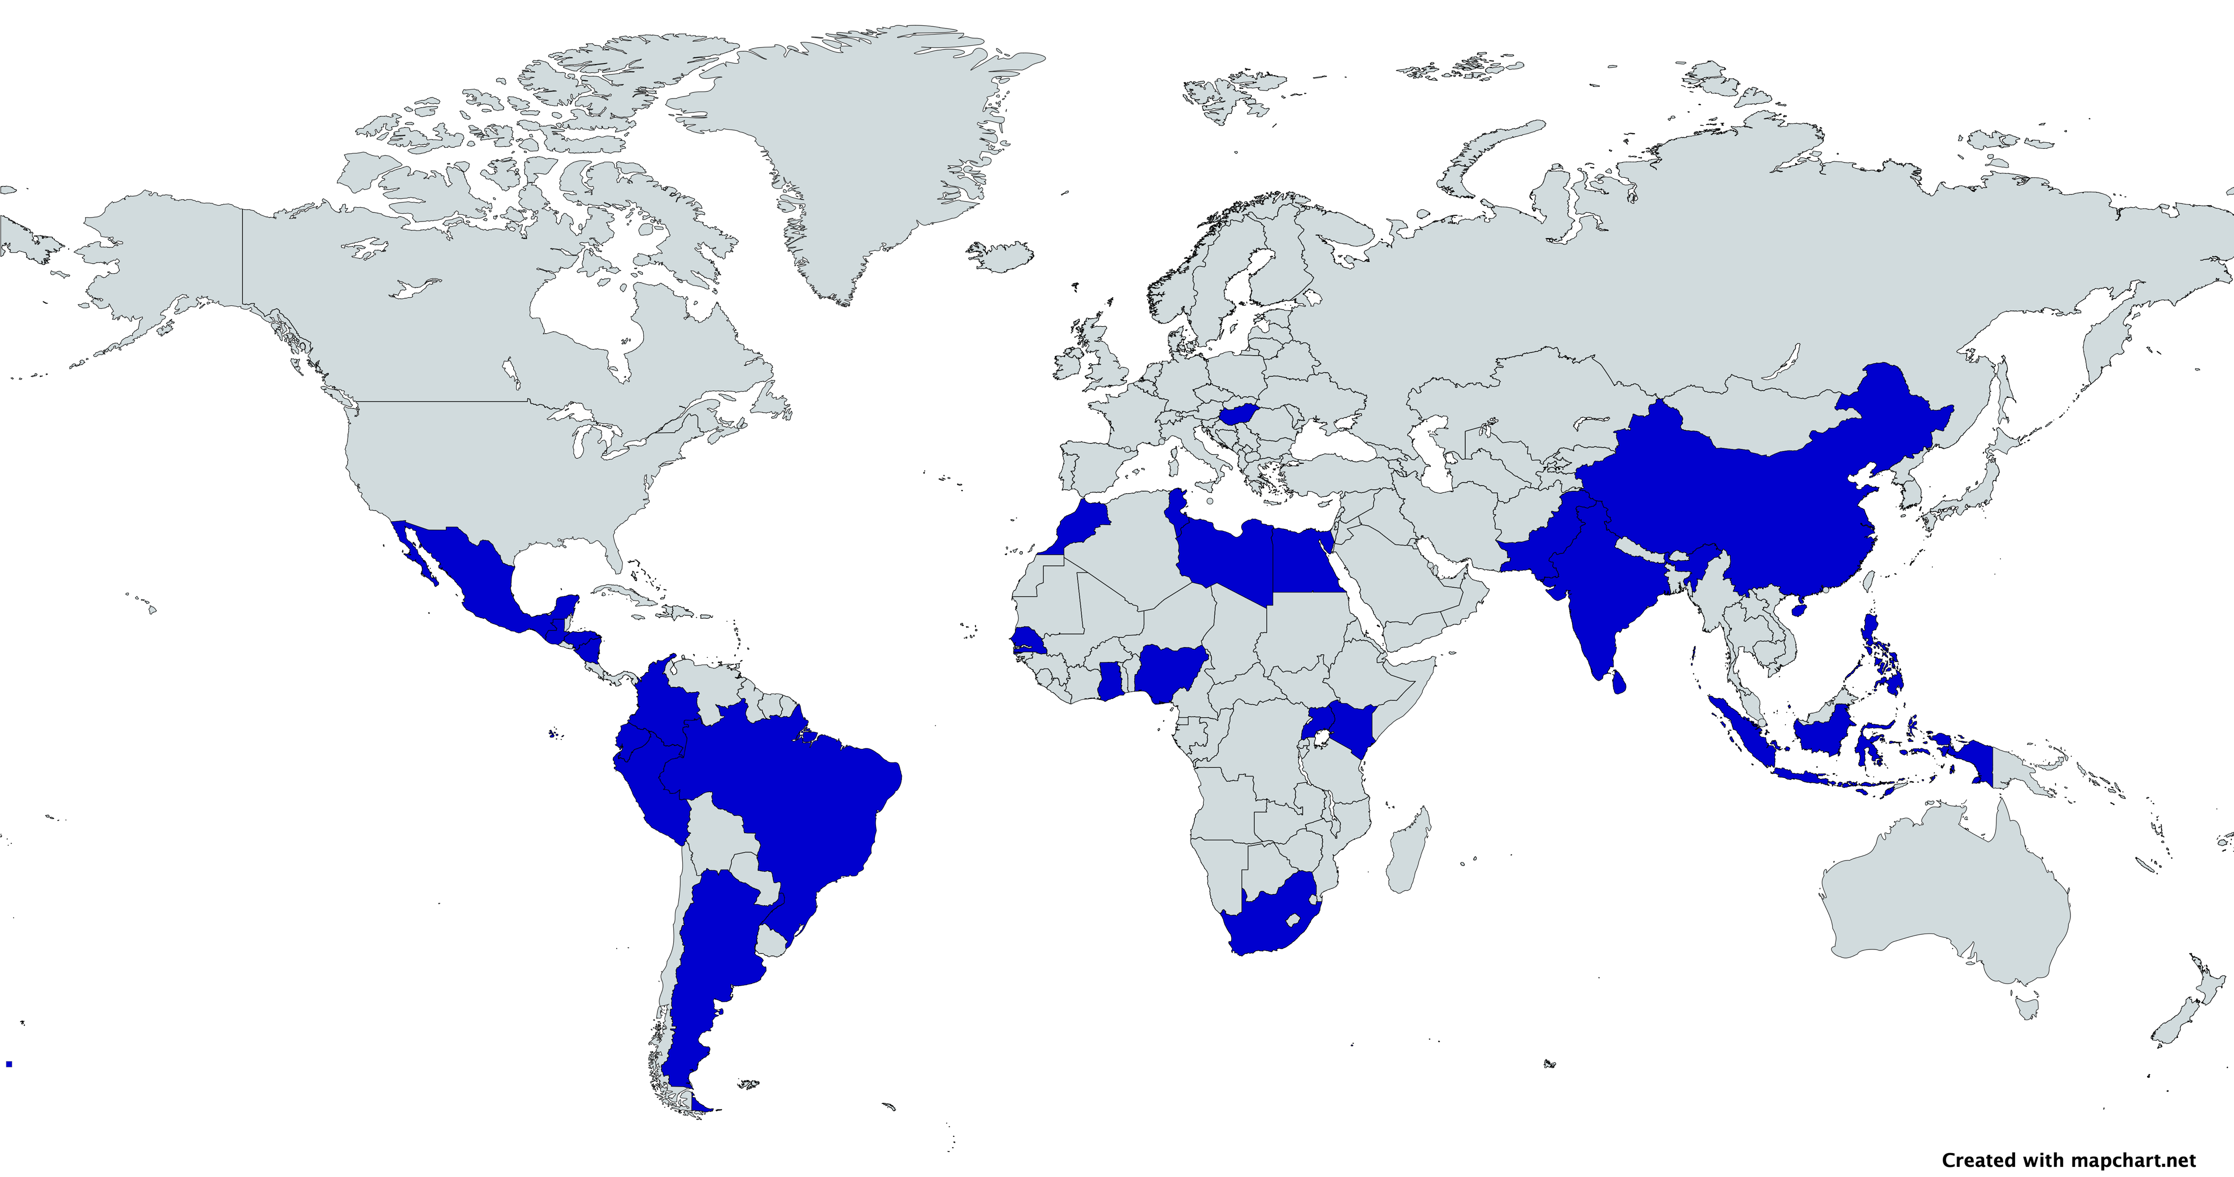
This is where the approach defers from previous ones: a modular multi-layer model (MLM) method was proposed which divide the object identification task and assign a batch of attribute to purposefully trained models. This MLM is composed of four layers, one for each RSSAT requirement, and its modular structure lays the groundwork for potential future improvements.
2. Database Creation
The tailored requirements set by the World Bank has forced the development of new methods for comprehensive road feature detection. The absence of valid and representative data often prohibits a full understanding of road safety risks. Therefore, the need for specific road attribute required dedicated datasets to feed our algorithm.
2.1. Data Collection
The data collection process has led to two types of datasets. Ones are downloaded from open-source databases and are already annotated, they all come from Open Image Dataset v7 (OIDv7). The others are mostly web scraped via Google Street View (GSV) or Mapillary API and are unannotated and will require manual labelling (done on the Roboflow website). These two datasets form the database which consists of both rural and urban locations as the road infrastructure in these contexts is varies a lot (e.g. bike lanes, crossings, more present in urban rather than rural areas). Notwithstanding the above-mentioned categories, the database is composed of images from both roads and motorways.
Overall, the database gathers around 30,000 pictures from various origins:
Open-source databases (OIDv7, CeyMo Benchmark Road Marking dataset)
Web scrapped data from APIs (Google Street View, Mapillary)
Manually collected data from Google Maps
Google Maps: 100% LMIC
The data collection process has filtered the countries of origin to specifically target Low- and Middle-Income Countries (see Figure 1):
OIDv7: 80% LMIC sourced pictures
CeyMo: 100% Sri Lanka
GSV: 100% LMIC
Mapillary: 100% LMIC
Fig. 1. Map showing the origin of the dataset across Low- and Middle-Income countries

Slide 5
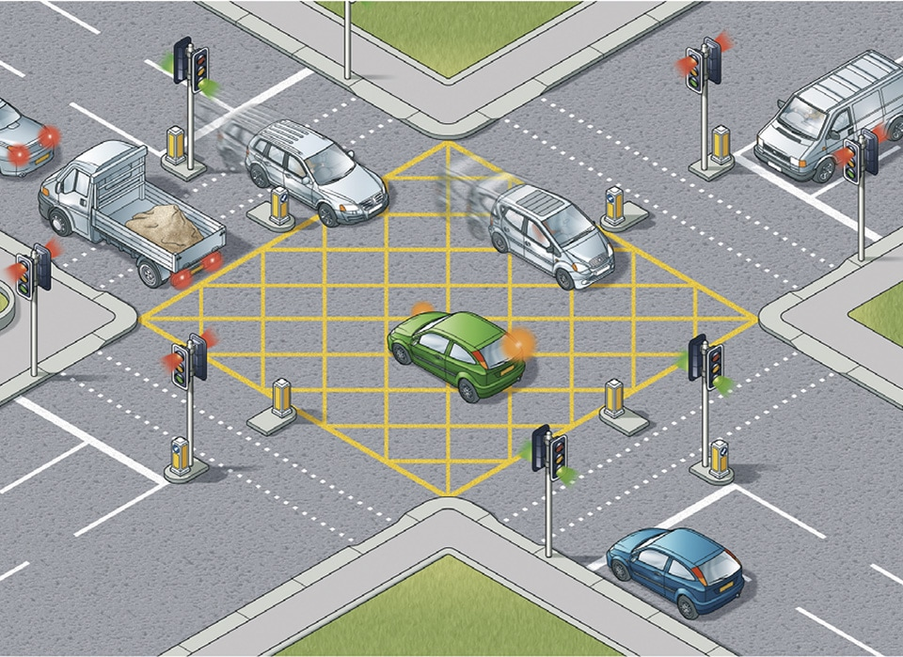

2.2. Data Cleaning and Integration
Amidst almost 30,000 pictures collected, some had to be removed because they were duplicates, some because they would bring nothing in terms of training (no feature to detect) or because they depicted too extreme context (sideway picture of the road, picture in the middle of a railroad, …).
Finally, it was necessary to ensure consistency in terms of coordinate systems and data formats (for labelling in .txt file) and structure (creation of training, testing and validation folders); when merging all the images from different sources to create a unified database. The database is divided into four datasets, one for each model.
3. Multi-Layer Model
Recently, deep learning methods have shown great success in computer vision, like lane detection algorithm based on a CNN^{[2]}. However, one common issue is that one model alone struggles to identify varying different types of shapes, i.e. it is hard to extract both lane marking, traffic signs and safety barriers using only one model.
A Multi-Layer Model (MLM) is trained on Ground-Level (GL), Aerial view (A), and detailed Lane & Road Marking (LRM) datasets. By training each of the GL object identification model, the satellite view object identification model, and the LRM identification model, on their side, the MLM comprehensively detects and classifies various road and traffic attributes, providing accurate road information to ease urban planning, traffic management, and infrastructure development in LMIC. Figure 2 provides an illustrative view of the MLM pipeline.
The differences between the objectives for each model is that the Python library YOLOv8 performs well when detecting boxes, polygons or lines, but not all at the same time.
3.1. Layer 1: Ground Level
The first layer of the multi-layer model consists of two sub-layers. Each of these two models has been trained on a specific dataset to detect certain classes.
The first model of this GL layer detects four of the road classes: car, tree, traffic light, traffic sign; while the second model detects a further nine road attributes amongst which include: physical median, central hatching, safety barrier, sidewalk, protected sidewalk, pole, bike lane and pedestrian marked crossings. Model 1 has been first to be trained, focusing initially on testing out the capabilities of YOLOv8, using the OIDv7 pre-labelled dataset. Model 2 has been trained and improved three times. The road attributes in these images were manually labelled using Roboflow, a dedicated online tool for labelling images to be trained using a CNN algorithm. However, the lack of precision for detecting bike lanes indicated the need of further training iterations
Fig. 2. MLM architecture
References
[2] Road markings dataset, 20,000 images: Lee, S., Kim, J. , Shin Yoon, J., Shin, S., Bailo, O., Kim, N., Lee, T.H., Seok Hong, H., Han, S.H., So Kweon, I.: VGPNet: Vanishing point guided network for lane and road marking detection and recognition. In: Proceedings of the IEEE international conference on computer vision. pp. 1947–1955 (2017)

Slide 6
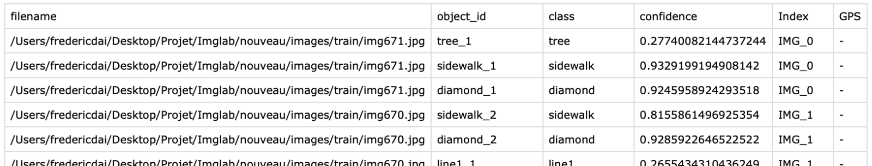
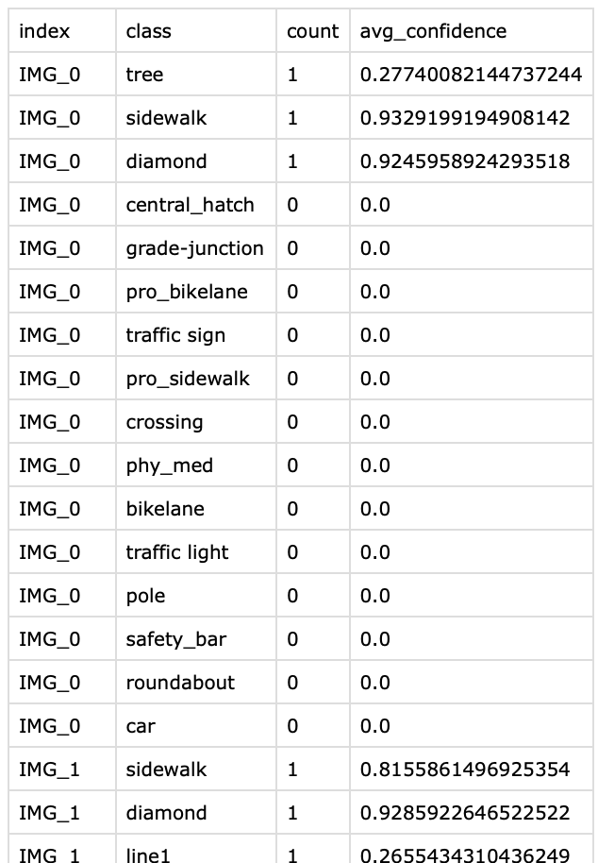
on dedicated dataset to improve this specific class detection performance. The new bike lane dataset allowed the third training iterations of the second model to be able to detect a wider range of bike lanes.
3.2. Layer 2: Aerial Level
The second layer consists of a YOLOv8 model for detecting intersection characteristics, such as: roundabouts and grade junctions. The specificity of this model, thus this layer, is its purpose and the dataset used. The dataset consisted of LMIC satellite images obtained from Google Maps (manually labelled using Roboflow). This model is initiated if and only if the user specify the need for aerial view detection. The focus shifted once it was recognized the limitations of the initial GL method when it came to detecting intersection, prompting the adoption to a new aerial perspective.
3.3. Layer 3: Lane & Road Marking
The third layer consists of a last YOLOv8 model for detecting road marking such as: direction arrows, diamond signals, slow signs, continuous lane marking such as edge lines, yellow markings, bike lanes, pedestrian marked crossings and bus lanes (which is a brand-new attribute, not required yet for the RSSAT).
This model come back to a ground-level point of view, allowing the reuse of the same LMIC originated training dataset as for Layer 1.
3.4 Merging the layers
The Multi-Layer Model can process as input either images, videos, or both (the videos are discretised as a series of pictures). To analyse a road, one can then input a series of ground-level pictures, which intersection is disjointed, or ground-level video of the road. Satellite pictures or videos are optional and can be avoided if the class identified by Layer 3 are not needed. The algorithm process each pictures one after another. Each model is applied one after another on every picture to extract its relative classes. This method allow for detailed object unique identification. The results are stored in grouped_result_detailed table which fields are: filename, object_id, class, confidence, Index (a file index), GPS (for now empty). This structure leaves the possibility for future work to address unique object level treatment.
Nevertheless, road safety attribute assessment require a different approach. The RSSAT requires specific road features, thus the detailed table is refined to aggregate results per road section. This formatted table summarises findings across distinct categories like: intersection characteristics, pedestrian crossings, roadside objects, and segment attributes. Objective evaluation criteria are applied throughout the analysis to interpret feature presence and condition. Criteria include cumulative counts, average confidences, and thresholds derived from the aggregated data to ensure consistent and reliable assessment outcomes.
Interactive elements are integrated all along the script to facilitate user inputs, to ease advancement and outputs saving, and to provide informative messages during script execution.
Class 1
Class 2
Class 3
Attribute 1
Attribute 2
…
…
Attribute Y
Class X

Slide 7
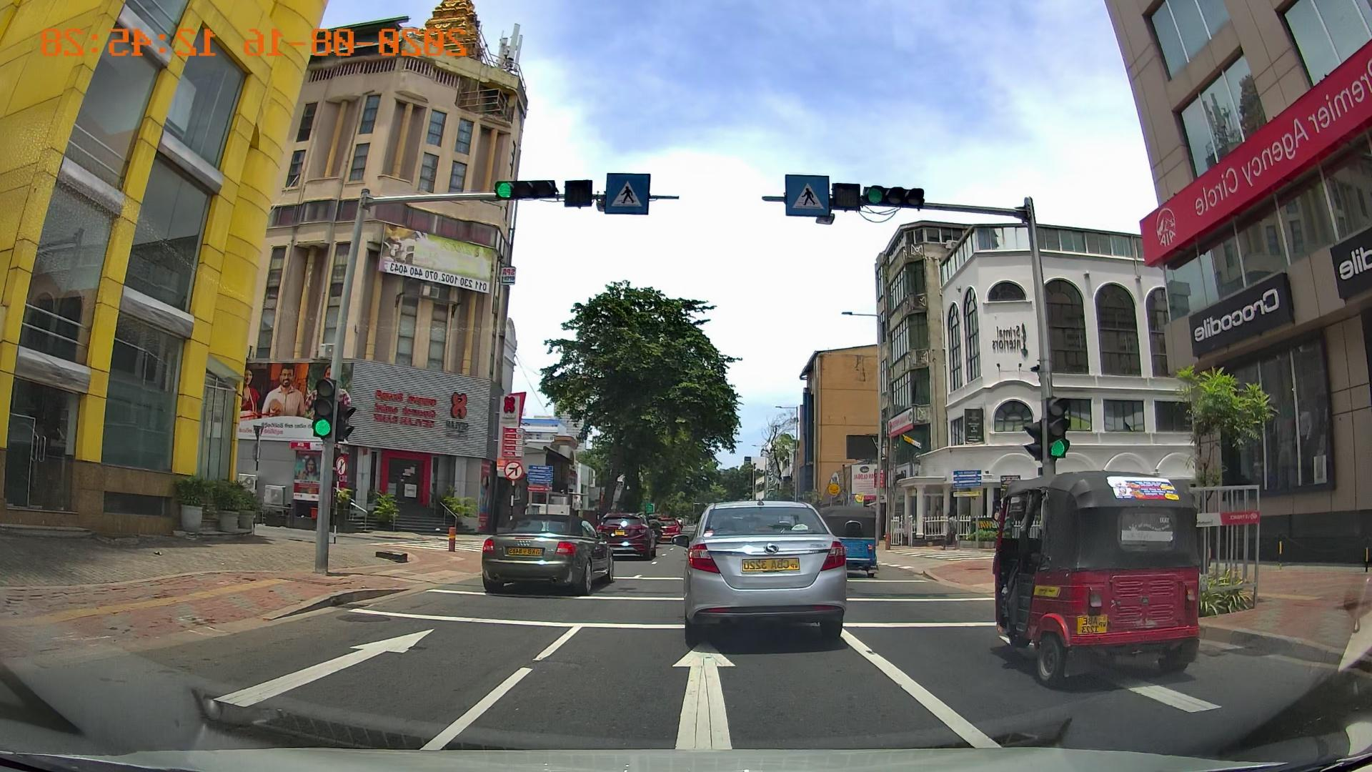
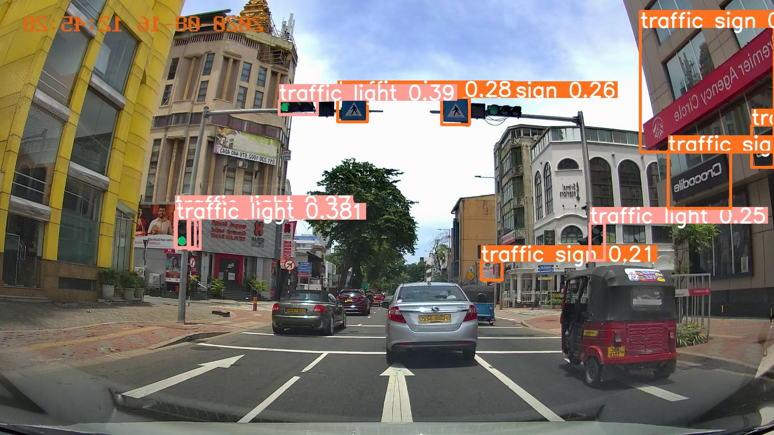
4. Results
How long did it take?
4.1. Layer 1
4.1.1 Model 1
INSERT TRAINING RESULTS INTERPRETATION
Fig. 3. Comparaison between input picture and detection of the Layer 1_1

Slide 8
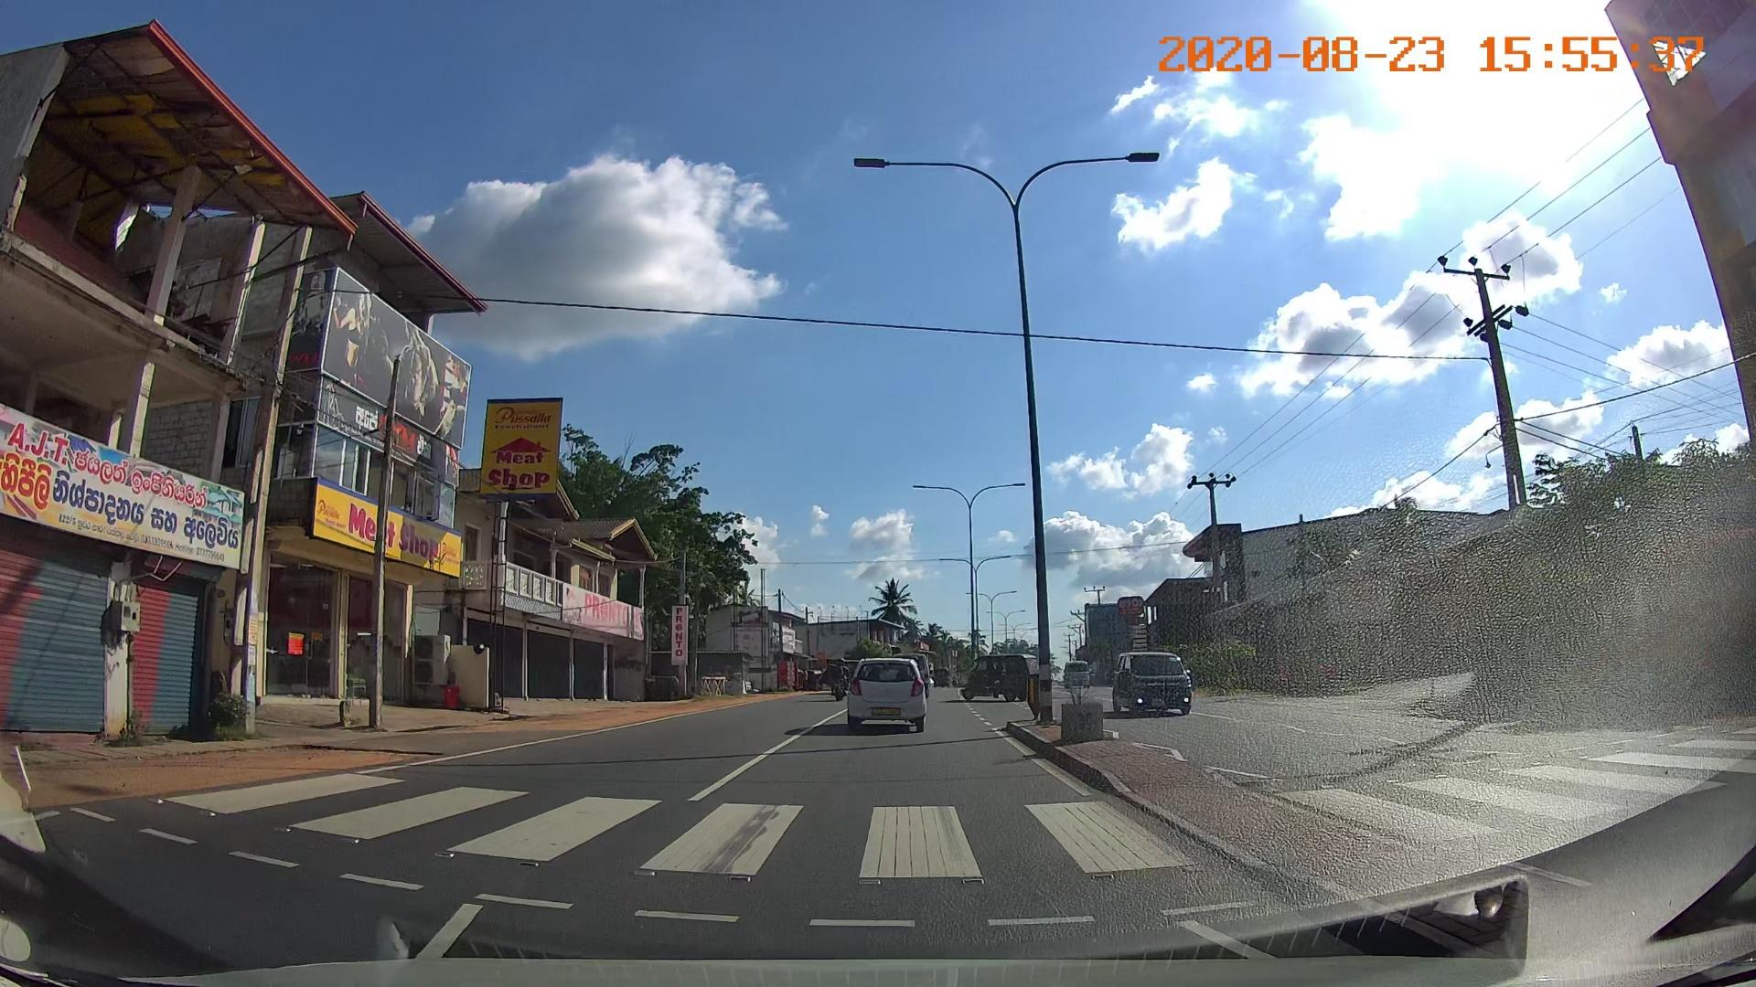
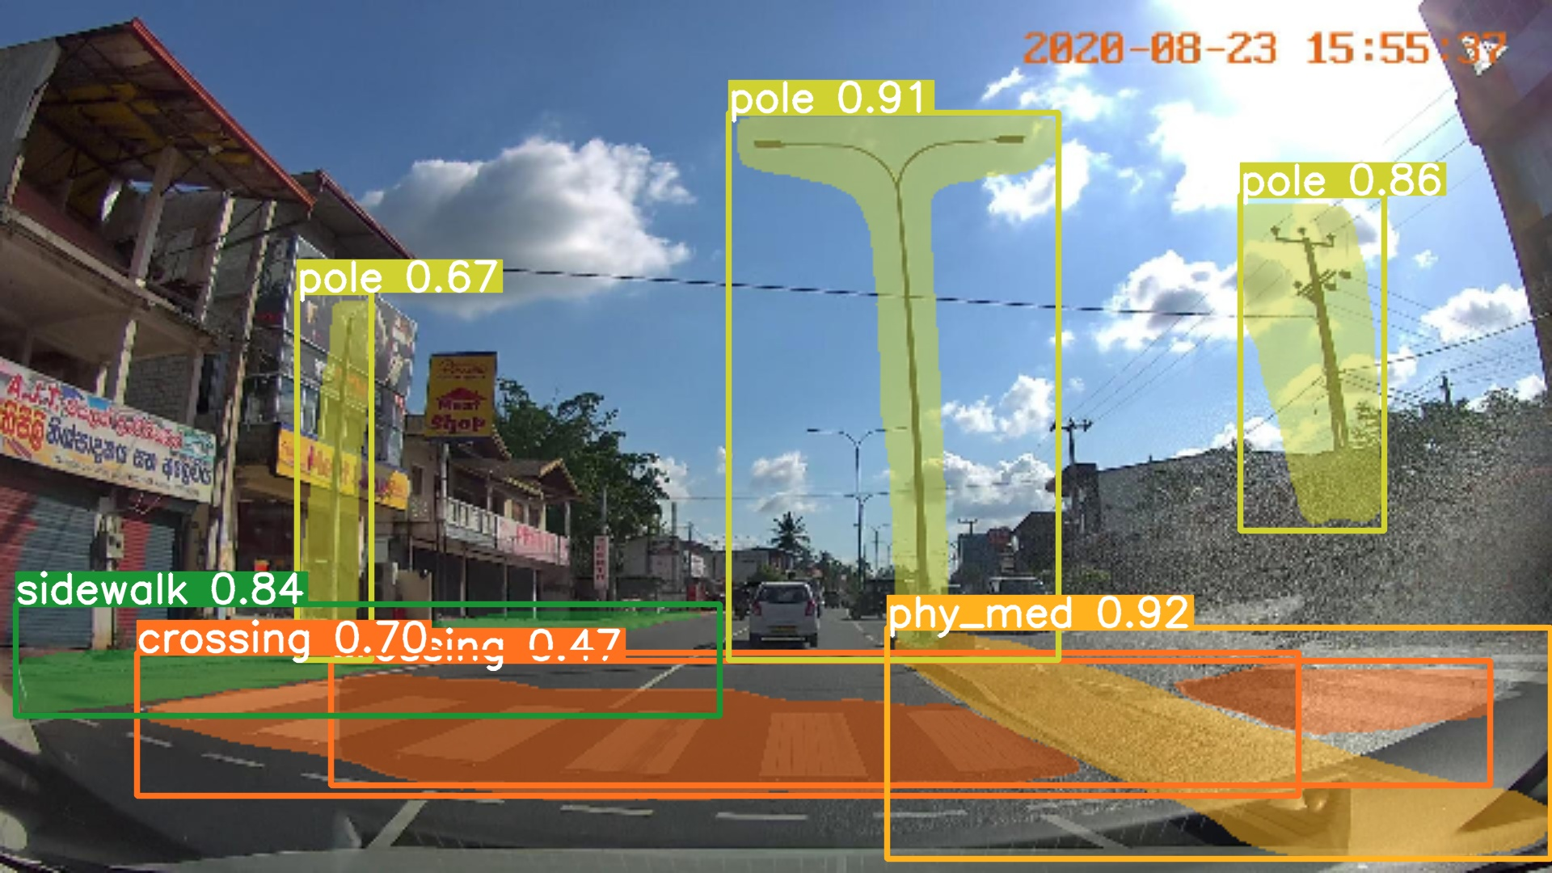
4.1.2. Model 2
This model, as mentioned in section 3.1. Layer 1: Ground Level, was trained three times using YOLOv8 with large optimization and 200 epoch each. This because the first iteration yielded poor results related to bike lane detection (17%). The initial dataset consisted in +2,000 images from 17 LMIC. To improve this, the team gathered 344 new bike lane images from 7 LMIC countries (mainly in Asia and Latin America) which were added to the initial database and were trained into the second iteration. Even though the second iteration was an improvement in the bike lane, mostly every other attribute decreased its accuracy. This caused the team to run a third iteration, but this time the training parameters were changed, which which influenced the randomization of the training. Specifically, this involved altering the value of the seed. A seed is the initial value used by a random number generator to start the generation of a sequence of pseudo-random numbers. This value ensures that the sequence of numbers can be replicated exactly if the same seed is used again, providing reproducibility and consistency in experiments and simulations. Seeds are used to control random processes, and by utilising this feature, the reliability of the experimental results was maintained.
In Appendix 14, a comparison between the three iterations can be seen. The metric is the value of the normalised confusion matrix for each attribute. Since the values of the third iteration are the highest, it is the chosen model. The improvement is clear against second iteration as the accuracy for bike lanes increased from 0.57 to 0.70, proving the usefulness of the change in the parameters.
It is important to note that the ‘Protected bike lane’ attribute was dismissed, as there were not enough images (that can highlight the high variety between regions) gathered, since there is generally a lack of bike lane infrastructure in LMICs.
Appendix 12 shows the normalised confusion matrix of the third iteration. Three classes have over 60% accuracy such as: bike lanes (70%), pedestrian crossing (68%) and physical median (62%). While the lowest ones are pole (39%) and protected sidewalk (42%). This mainly caused by the high variability of poles and protected sidewalks, potentially caused by differences in box annotations.
In figure 4, it can be seen an input picture without annotations (left) and an image with the annotations predicted from the model (right).
INSERT TRAINING RESULTS INTERPRETATION BUT NOT AS MUCH AS MODEL 1
Fig. 4. Comparaison between input picture and detection of the Layer 1_2

Slide 9
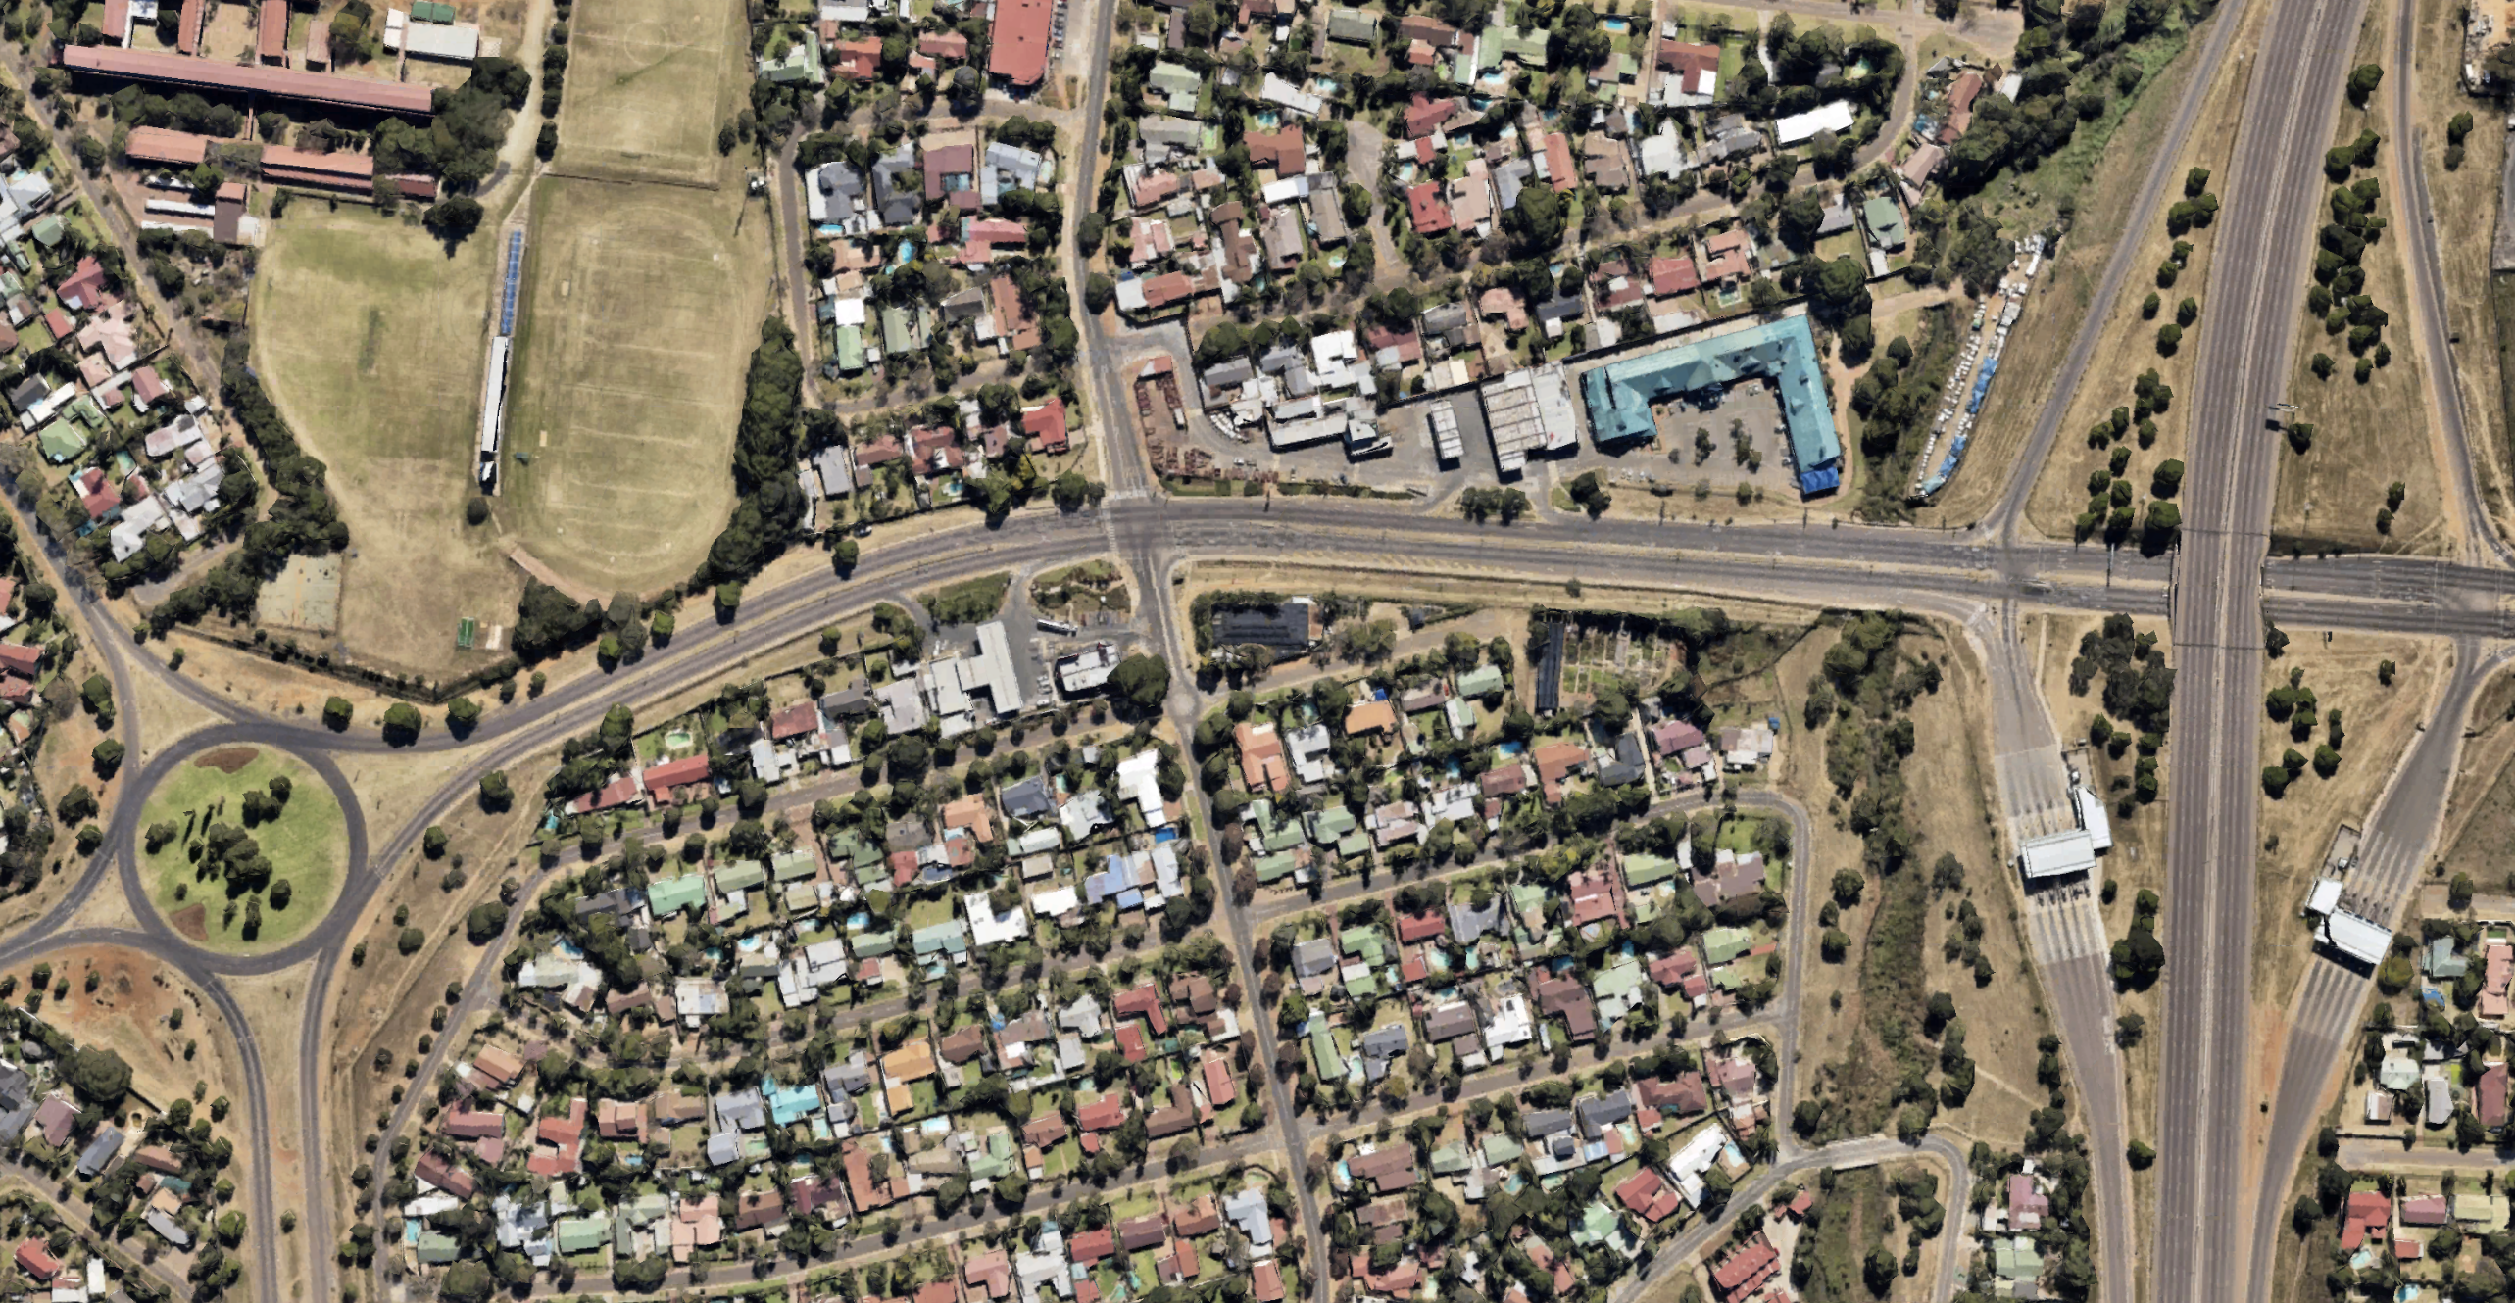
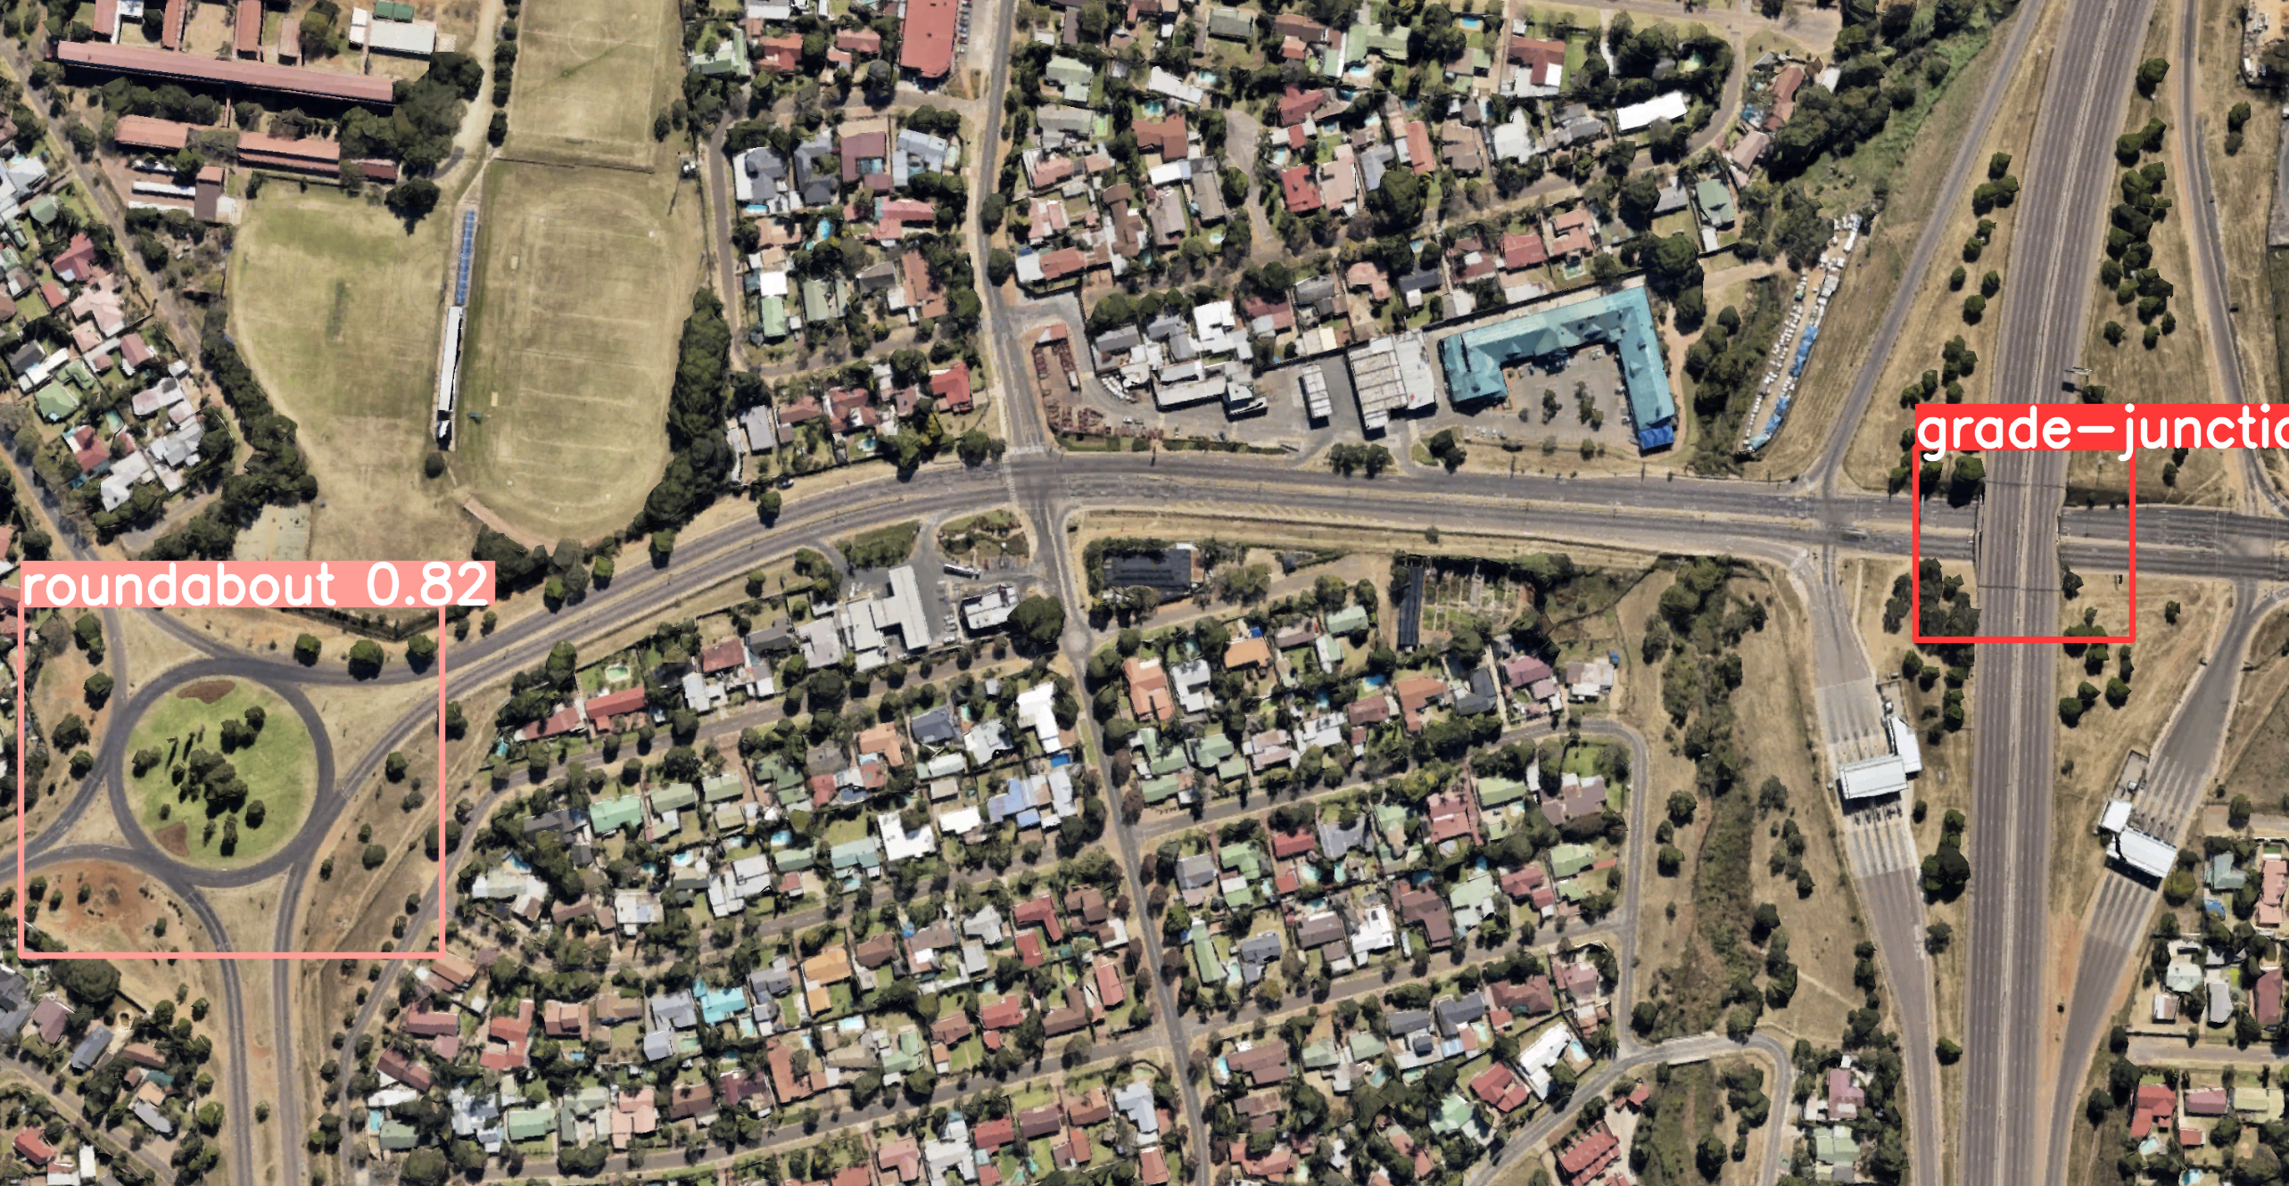
4.2. Layer 2
The dataset that trained the model consisted of 1,069 unique satellite images obtained from Google Earth in 21 LMIC, manually labelled using Roboflow, which were flipped horizontally and vertically, and changed in their brightness to finally add up nearly 4,000 images.
REDUCE THIS TRAINING PARAGRAPH AS IT WILL BE MOSTLY EXPLAINED FOR MODEL 1
YOLOv8 algorithm was trained with 200 epochs and large optimization. The training results can be seen in Appendix 3. There, the first three graphs (“train/box_loss”, “train/cls_loss”, “train/dfl_loss”) indicate that the higher amount of epoch the error of the model decreased, showing the utility of using a high-performance computer capable of running many epochs in a shorter amount of time. The 6th graph (“val/box_loss”) indicates that the model can put within a box the attributes while the 7th graph (“val/cls_loss”) shows that the model is stable to indicate the correct classification of the attribute. Also, the 8th graph (“val/dfl_loss”) shows that the error of detecting objects with various scales and aspect ratios increases, potentially because the high variance between the grade junctions used in their size. Additionally, the 4th graph (“metrics/precision”) indicates that the accuracy of the detected objects is stable as more epochs are considered. The 5th graph (“metrics/recall”) shows that the ability of the model to identify all instances of objects in the images slightly decreases which can also show some variability in the data. The last two graphs, the 9th (“metrics/mAP50”) and 10th (“metrics/mAP50-95”) indicate that the precision of detection with threshold lower than difficulty of 0.5 (easy to detect) and between 0.5 and 0.95 (hard to detect) slightly decreases the higher the epochs.
In Appendix 11, the confusion matrix can be seen at 50% confidence, where the model detects 53% of the grade junctions and 77% of the roundabouts correctly. The mismatch between attributes is very low (1% and 2%) indicating that the model when detecting the attribute has a high precision, but most of the error comes from not detecting the attribute.
In Appendix 7, the graph shows that the F1-Score, reaches a peak of 0.54 at 29% of confidence, and it is clear the difference in lower metrics for grade junctions compared to the roundabouts.
The Precision-Confidence curve in Appendix 8, shows the difference in accuracy of the detected objects for both attributes, in easier objects the roundabout accuracy is higher than grade junctions by more than 10%. While in Appendix 9, the Recall-Confidence curve, shows the ability of the model to identify all instances of objects in the images, where it decreases for both attributes which is expected, but the decline is sharper for grade junctions and constant, while for roundabouts the decline is not sharp until 50% confidence.
The labelled image (left) and the predicted image (right) are shown in the next figure, obtained from the model as examples of the algorithm working in practice.
4.3. Layer 3
The third layer was designed to detect mostly road lines and signalling. For this, a CeyMo dataset was used that consisted in more +2,000 unique pictures, it is known some images come from LMIC (such as Sri Lanka), but precise location is not certain.
Model 4 was trained using YOLOv8 algorithm with the large modelling optimization setting with 200 epochs run.
INCLUDE SOME TRAINING RESULTS OUTPUT
Fig. 5. Comparaison between input picture and detection of the Layer 2

Slide 10
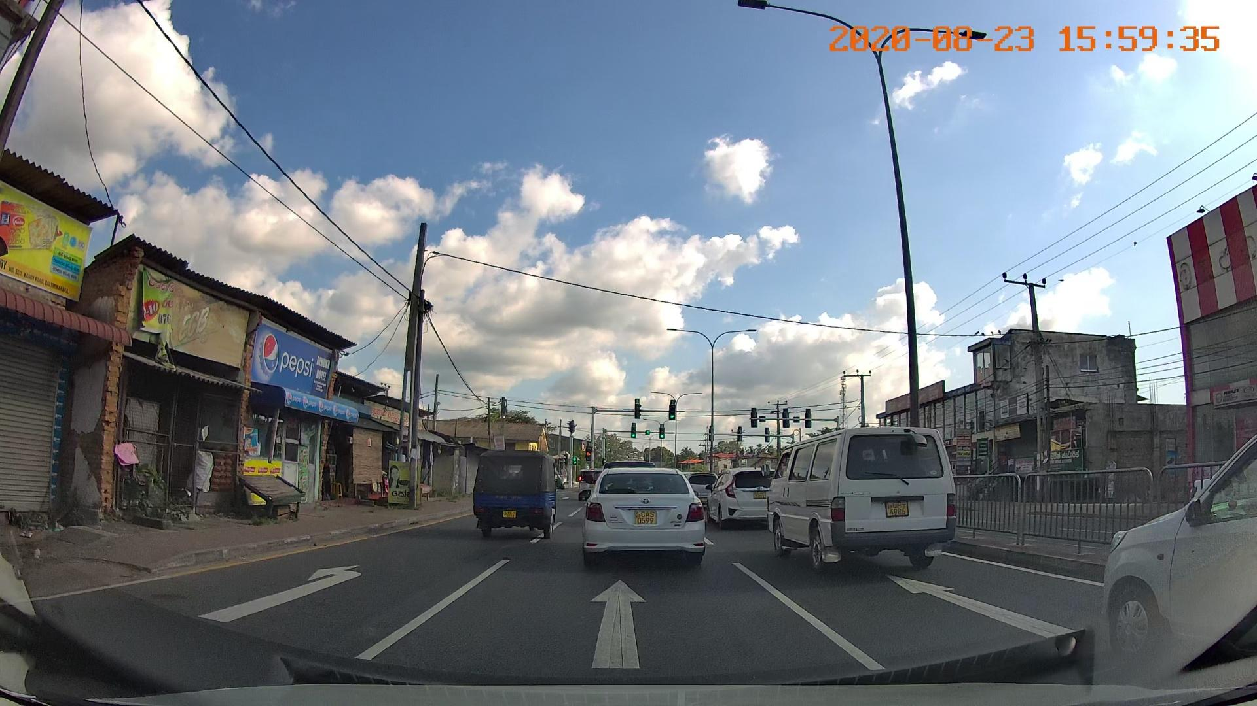
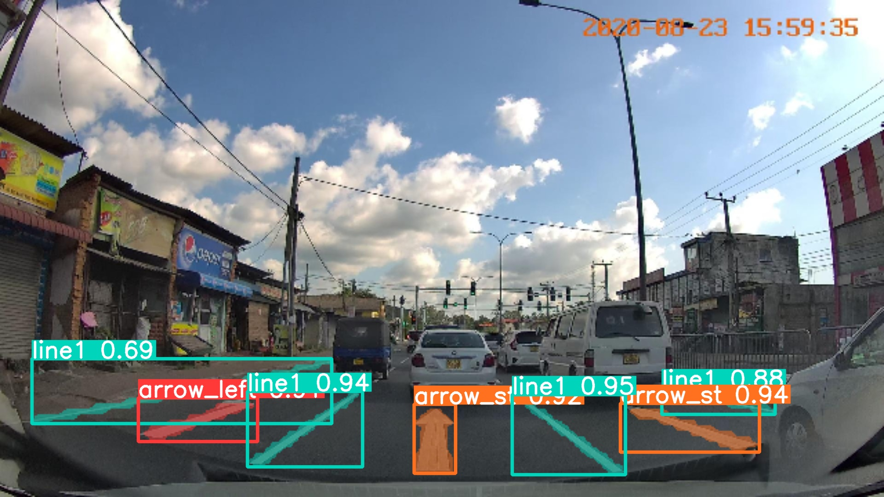
The confusion matrix for this model is shown in Appendix 12, and it is evident from this that the model has produced highly accurate results. The obvious bold diagonal in this matrix indicates that each attribute is mostly predicted correctly, as the true attributes are on the x axis and the predictions are shown on the y axis.
Below there is an example of the labelling in model 4, showing both the correctly labelled attributes in the left image, and the predicted labels from the model in the image on the right. It is evident here that most attributes were detected, and as well as this, the bounding boxes identified by the fourth model were highly accurate.
Fig. 6. Comparaison between input picture and detection of the Layer 3

Slide 11
5. Requirements
5.1. Technical requirements
The requirements listed below are intended to ensure optimal performance for both training a YOLOv8 model and running detection tasks. Training a YOLOv8 model is computationally intensive and requires robust hardware and software specifications while running detection tasks typically requires fewer resources than training unless deployed in real-time.
For software, YOLOv8 supports multiple operating systems, including Windows (≥ 10, 64-bit), Ubuntu (≥ 18.04), and macOS (≥ 10.15). Python (≥ 3.7) is necessary as primary programming language, with essential libraries and frameworks such as: PyTorch (≥ 1.7.0), CUDA Toolkit (≥ 10.2) (for GPU support), compatible cuDNN, OpenCV (≥ 4.0), NumPy, SciPy, Matplotlib, Pillow, and optionally TensorRT for optimized inference on NVIDIA GPUs.
On the hardware front, YOLOv8 necessitates a robust configuration. The CPU should ideally be an Intel i5 (8th Gen or higher) or AMD Ryzen 5 (3000 series or higher), featuring a minimum of 4 cores and 8 threads. For accelerated performance, an NVIDIA GPU with CUDA capability 6.0 or higher is recommended, with the NVIDIA RTX 2060 or higher being optimal (≥ VRAM 8GB). To support these components, a minimum of 16 GB RAM is recommended.
Training machine learning models requires powerful GPUs for intensive computations and substantial CPU power and RAM for managing large datasets and complex calculations. In contrast, detection can run on less powerful GPUs and requires less CPU and RAM, though it still benefits from GPU acceleration and sufficient system resources.
In conclusion, adhering to these specifications ensures that YOLOv8 operates efficiently on your system, leveraging both software capabilities and hardware performance for optimal results in object detection and related tasks.
Also note that a recommended 100 GB SSD might be needed to reckon with the training database and models’ weights storage.
5.2. Input requirements
The MLM relies on YOLOv8 which can process both pictures or videos. When initiating the models, the MLM algorithm asks for the need (or not) for aerial view detection. If not needed, only Layer 1 and 3 will be initiated and road information can be input as either a series of pictures (above Standard Definition (SD) 640x360 pixels (360p), preferably High Definition (HD) 1280x720 pixels (720p)) with null intersection, or a single shot video (same resolution requirements, frame rate of 30 fps).
In the case one want to add satellite images as an input, the MLM will initiate all layers to treat the two types of input (ground and aerial level). The resolution requirements for the aerial point of view are the same as for ground level, either it is a series of picture or a video. However, the scale is third parameter to consider here. When web scrapping the data via Google Maps, a zoom level 15 or higher will roughly correspond to a scale of 1:20,000. This setting allow small town to road level precision which is exactly what the Layer 2 is design for.

Slide 12
6. Limitations and future work
Despite the promising results achieved by the Multi-Layer Model for road and traffic attribute detection, several limitations can be addressed to enhance its effectiveness and generalisability.
Firstly, the MLM's performance is closely tied to the quality and diversity of the datasets. Additionally, the current model struggles with detecting and classifying objects when presented with cluttered or occluded scenes, which are common in real-world scenarios. Furthermore, the reliance on the… This limitation underscores the need for more sophisticated approaches that can handle complex and overlapping annotations more effectively.
Future work will focus on addressing these limitations through several key areas of improvement. Enhancing the annotation quality and consistency across datasets is paramount, potentially with semi-automated or crowdsourced annotation methods to ensure a more uniform and comprehensive training dataset. Expanding the dataset to include more varied and challenging real-world scenarios will also be crucial for improving the model's robustness. Finally, on the model front, incorporating techniques such as data augmentation, transfer learning, and domain adaptation can help to mitigate the limitations posed by diverse data sources and enhance the model's adaptability to different environments.
6.1. Limitations
Although YOLOv8 has demonstrated strong performance in various object detection tasks, as shown previously, several limitations must be considered for optimal deployment in complex scenarios. Firstly, YOLOv8 tends to struggle in accurately detecting small objects within large images, because its grid division strategy leads to small objects being easily missed or inaccurately detected. Secondly, YOLOv8’s performance decreases with overlapping or densely distributed objects, as it only predicts one object per grid, causing multiple overlapping objects to be recognized as a single object. Lastly, although YOLO has a very high detection speed, in some cases its detection accuracy is lower compared to other slower object detection algorithms (such as Faster R-CNN). This is particularly true in scenarios where high-precision detection is required, making YOLOv8 a less optimal choice.
Regarding data sources, acquiring data from platforms like Google Maps, Mapillary, or CeyMo presents significant challenges for many low- and middle-income countries. These platforms often have data coverage that is biased towards developed countries and major cities, resulting in sparse data for developing and remote regions. Additionally, certain attributes listed by sources like the World Bank, such as protected bike lanes, are difficult to find in LMIC. These countries often have less developed infrastructure, and the relevant data collection and recording are not as comprehensive.
Despite efforts to collect relevant coordinates, a standardized method to differentiate between urban and rural areas is lacking. Ultimately, while on the whole, the database compiles miscellaneous weather conditions, limited variations of each location were gathered. As a result, data for the same location across different conditions is insufficient, thereby restricting the understanding of how environmental changes impact transportation and infrastructure.
6.2 Future Research Directions
It is noted that the current algorithms used are existing algorithms sourced from open online libraries and adapting them to integrate the new data sources. To achieve the desired outcomes, set by the World Bank, the focus

Slide 13
was directed to creating a comprehensive list of attributes and improving the accuracy of the object detection algorithm. However, one of the main directions for the continuation of this research could be to compose a new algorithm, with similar capabilities as the current version but with a completely original script.
Currently, annotation process requires manual labelling. However, one way to improve efficiency and accuracy is to implement auto-labelling technology. This transition will not only significantly reduce the manual workload but also greatly enhance data processing speed and consistency. Auto-labelling will leverage advanced algorithms and machine learning techniques to ensure that annotation tasks are completed efficiently and accurately, thereby improving the overall workflow efficiency and quality.

Slide 14
To address the identified limitations and enhance data collection and analysis, it is possible to establishing partnerships with local governments, NGOs, and research institutions in developing countries to access more localized data and collaborating with international organizations for broader data collection. Additionally, diversifying our data collection methods by incorporating crowd-sourcing, satellite imagery, and mobile data collection apps, and promoting the use of open data platforms will ensure a wider range of data types and sources, thereby improving the robustness and comprehensiveness of our dataset. For example, similar to the road markings attribute, a point of note for the continuation of the research in future would be to shift the focus onto ensuring that the multi-layer model would be able to detect bike lanes in model 2 with less obvious features and with somewhat faded bike lane markings. Again, this is particularly relevant for road attributes in low-and middle-income countries.
For model:
Google Maps API offers the possibility to obtain satellite images given specific coordinates. Simultaneously, Google Street View help accessing 360° panoramic views and images of the very same locations. For future improvements, one might want to focus on depth estimation[X] of the different objects detected on ground-level images in order to determine their GPS coordinates. Obtaining images from an API based on the coordinates is a straightforward task, thus allowing seamless match of aerial and ground-level data. Another way to improve this MLM could be to rely on satellite image datasets, which typically include files indicating coordinates. With this GPS data, new developers can integrate GPS treatment in merging part of the MLM which has purposefully been design for GPS data integration.
Threshold Establishment: Analyse and provide clear recommendations on optimum thresholds for the interval distance of street view images (e.g., 100 metres) used for object counting.
References
[3] Mapillary (2023). Object detections. [online] Mapillary. Available at: https://help.mapillary.com/hc/en-us/articles/115000967191-Object-detections [Accessed 21 Jun. 2024].

Slide 15
6.3. Novelty of the research
Mapillary computer vision technology is potentially the leader in object detection for street images. As of 2023, they declare a list of 65 classes of objects they can detect [3]. Considering this list, it can be noted that some key attributes that the RSSAT model is able to detect are not present in Mapillary, such as: central hatching, physical median and safety barrier for median type; the difference between a sidewalk and a protected sidewalk which is only indicated as “pedestrian area”.
Lastly, it does not have an aerial view meaning that it cannot detect the roundabouts neither grade junctions, though from street view it is able to detect “bridges” which might be the most similar one.
Other innovative aspect of this research is the focus of the images being from low and medium income countries (following the World Bank classification), as other studies have focused on (1) only developed countries such as Yang et al. (2022) in Europe and Japan, Braum et al. (2018) in Europe, Voth (2024) in Germany, Moschos et al. (2023) in Greece; (2) on both high and low income countries (a global view) such as research from Neuhold et al. (2017), Arya et al. (2021) in India, Japan and Czech, Chen et al (2021) globally, Luo et al (2023) in Europe, China and Unites States; while only a few focus on specific developing countries such as Escallón (2023) in Colombia and Güney and Bayilmiş (2021) in Turkey; but not many of them.
INCLUDE STATE OF ART OF ROAD MARKING AND TRAFFIC LIGHTS

Slide 16
6. Conclusion
The modularity of approach of allows further analysis tool to be aggregated to the Multi-Layer Model. One might find interesting to ….
In conclusion, the Multi-Layer Model introduces a novel approach to [specific problem], demonstrating [key findings]. This contributes to [field] by [specific contribution]. Future research could expand on these findings by [brief mention of potential future work].
Some attribute are still missing due to a lack of quantifiability (shoulder width, pedestrians, …)
for future projects to thoroughly track unique objects’ GPS coordinates and generate a Digital Twin of the road.
7. Acknowledgements
The authors would like to thank Professor Mohammed Quddus, Shaofan Sheng, and Felix Feng of Imperial College London for the assistance and support they were able to provide throughout the course of this project upon which this paper is based.

Slide 17
8. References
[1] Liu, X., Deng, Z., Lu, H., and Cao, L., 2017. Benchmark for road marking detection: Dataset specification and performance baseline. In: 2017 IEEE 20th International Conference on Intelligent Transportation Systems (ITSC), pp. 1–6. IEEE.
[2] Lee, S., Kim, J., Shin Yoon, J., Shin, S., Bailo, O., Kim, N., Lee, T.H., Seok Hong, H., Han, S.H., and So Kweon, I., 2017. VGPNet: Vanishing point guided network for lane and road marking detection and recognition. In: Proceedings of the IEEE International Conference on Computer Vision, pp. 1947–1955.
[3] Mapillary (2023). Object detections. [online] Mapillary. Available at: https://help.mapillary.com/hc/en-us/articles/115000967191-Object-detections [Accessed 21 Jun. 2024].
[4] Yang, Z., Zhao, C., Maeda, H. and Sekimoto, Y. (2022). Development of a Large-Scale Roadside Facility Detection Model Based on the Mapillary Dataset. Sensors, 22(24), p.9992. doi:https://doi.org/10.3390/s22249992.
[5] Braun, M., Krebs, S., Flohr, F. and Gavrila, D.M. (2019). The EuroCity Persons Dataset: A Novel Benchmark for Object Detection. IEEE Transactions on Pattern Analysis and Machine Intelligence, [online] 41(8), pp.1844–1861. doi:https://doi.org/10.1109/TPAMI.2019.2897684.
[6] Voth, R.S. (2024). Real-time detection of German street signs. [online] reposit.haw-hamburg.de. Available at: https://reposit.haw-hamburg.de/handle/20.500.12738/14527 [Accessed 21 Jun. 2024].
[7] Moschos, S., Charitidis, P., Doropoulos, S., Avramis, A. and Vologiannidis, S. (2023). StreetScouting dataset: A Street-Level Image dataset for finetuning and applying custom object detectors for urban feature detection. Data in Brief, p.109042. doi:https://doi.org/10.1016/j.dib.2023.109042.
[8] Neuhold, G., Ollmann, T., Rota Bulo, S. and Kontschieder, P. (2017). The Mapillary Vistas Dataset for Semantic Understanding of Street Scenes. [online] openaccess.thecvf.com. Available at: https://openaccess.thecvf.com/content_iccv_2017/html/Neuhold_The_Mapillary_Vistas_ICCV_2017_paper.html [Accessed 21 Jun. 2024].
[9] Arya, D., Maeda, H., Ghosh, S.K., Toshniwal, D., Mraz, A., Kashiyama, T. and Sekimoto, Y. (2021). Deep learning-based road damage detection and classification for multiple countries. Automation in Construction, 132, p.103935. doi:https://doi.org/10.1016/j.autcon.2021.103935.
[10] Chen, Y., Chen, L. and Li, Y. (2021). Recognition algorithm of street landscape in cold cities with high difference features based on improved neural network. Ecological Informatics, 66, p.101395. doi:https://doi.org/10.1016/j.ecoinf.2021.101395.
[11] Luo, Z., Gao, L., Xiang, H. and Li, J. (2023). Road object detection for HD map: Full-element survey, analysis and perspectives. ISPRS Journal of Photogrammetry and Remote Sensing, 197, pp.122–144. doi:https://doi.org/10.1016/j.isprsjprs.2023.01.009.
[12] Escallón Páez, F. (2023). BEDPI-DL: Built Environment objects Detection on Panoramic Images of Bogota with Deep Learning models. repositorio.uniandes.edu.co. [online] Available at: https://repositorio.uniandes.edu.co/entities/publication/0393c193-1eec-4197-aec7-4d1a75c1d104 [Accessed 21 Jun. 2024].

Slide 18
[13] Güney, E. and Bayılmış, C. (2021). An Implementation of Traffic Signs and Road Objects Detection Using Faster R-CNN. SAKARYA UNIVERSITY JOURNAL OF COMPUTER AND INFORMATION SCIENCES, [online] 5(2). doi:https://doi.org/10.35377/saucis.05.02.1073355

Slide 19
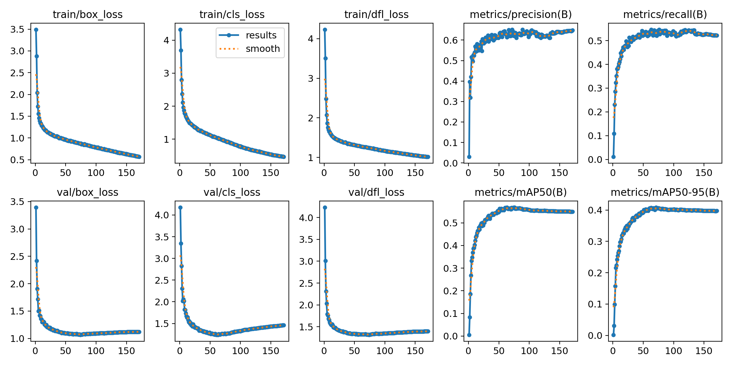
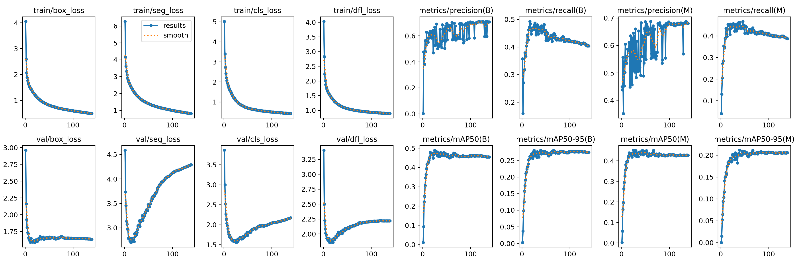
9. Appendices
Appendix 1. Performance metrics for Layer 1_1
Appendix 2. Performance metrics for Layer 1_2

Slide 20
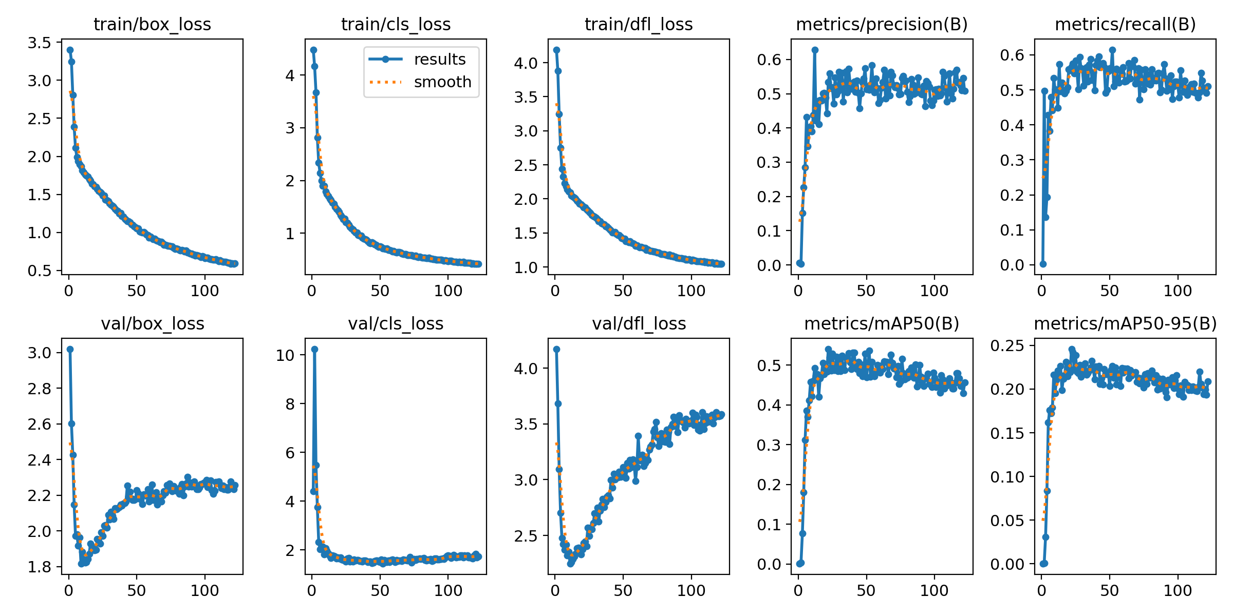
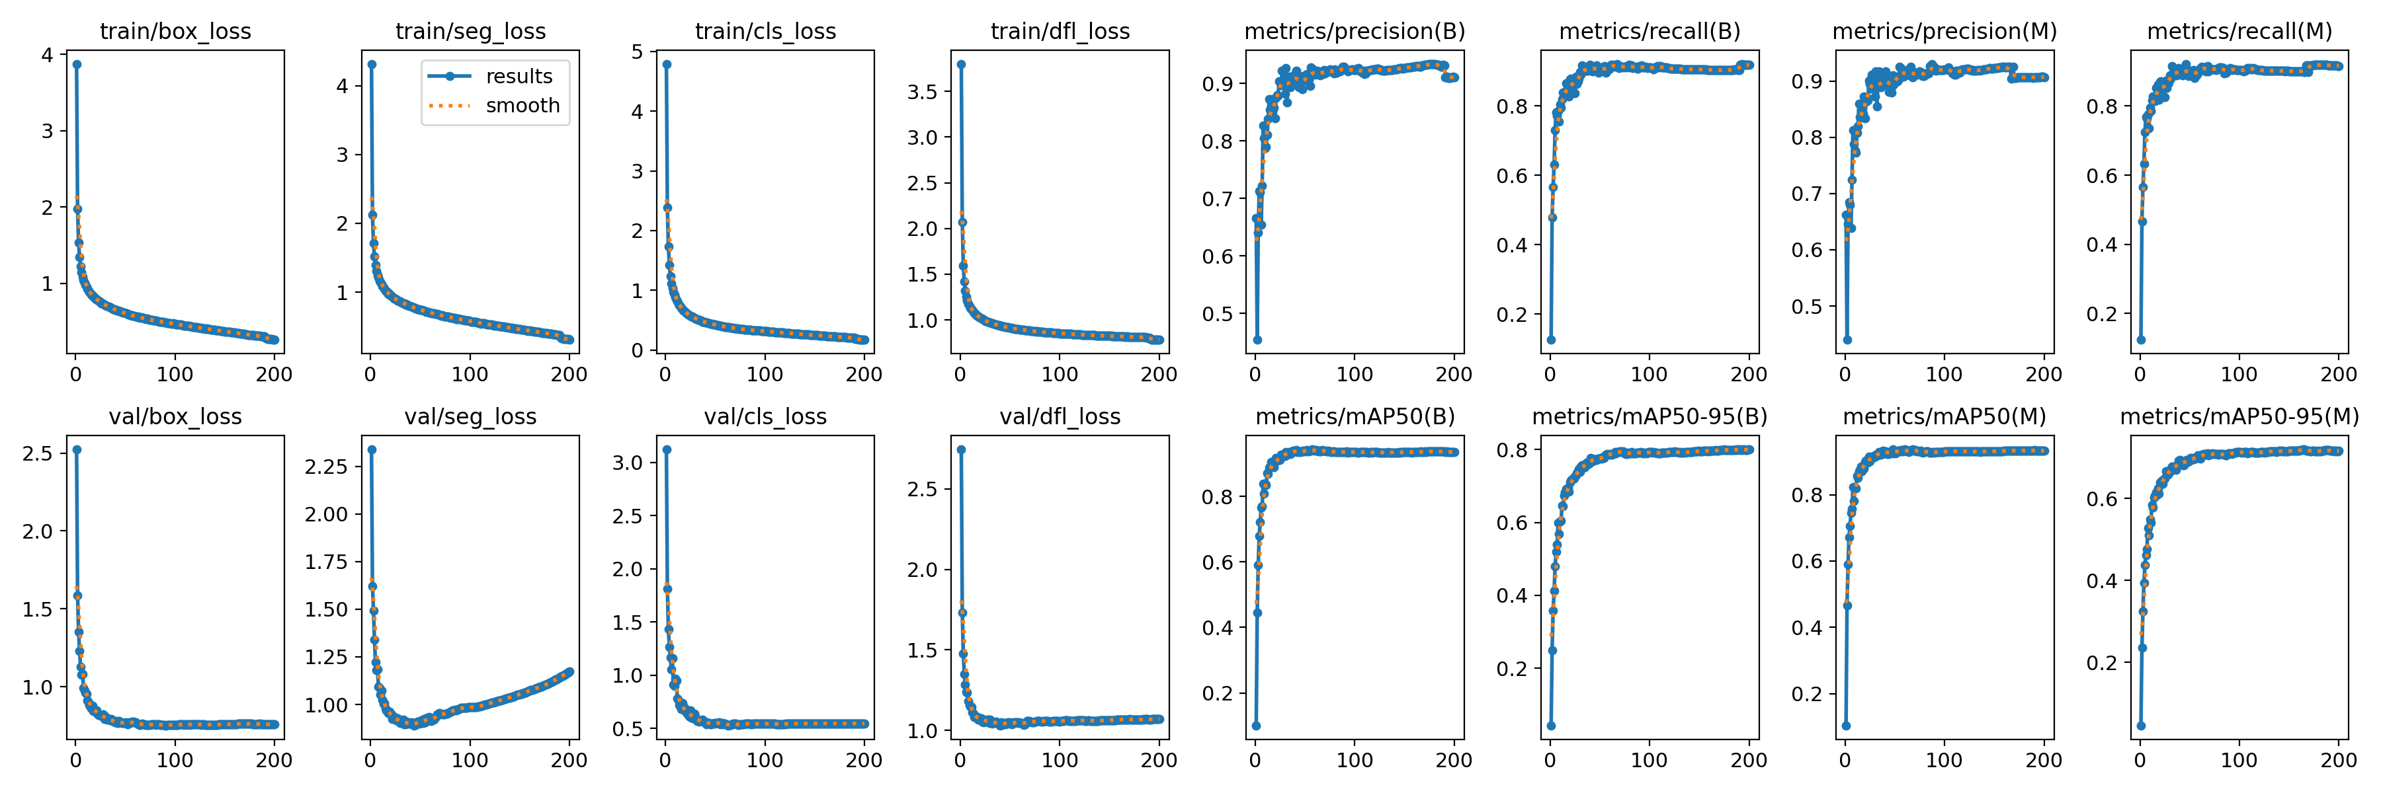
9. Appendices
Appendix 3. Performance metrics for Layer 2
Appendix 4. Performance metrics for Layer 3

Slide 21
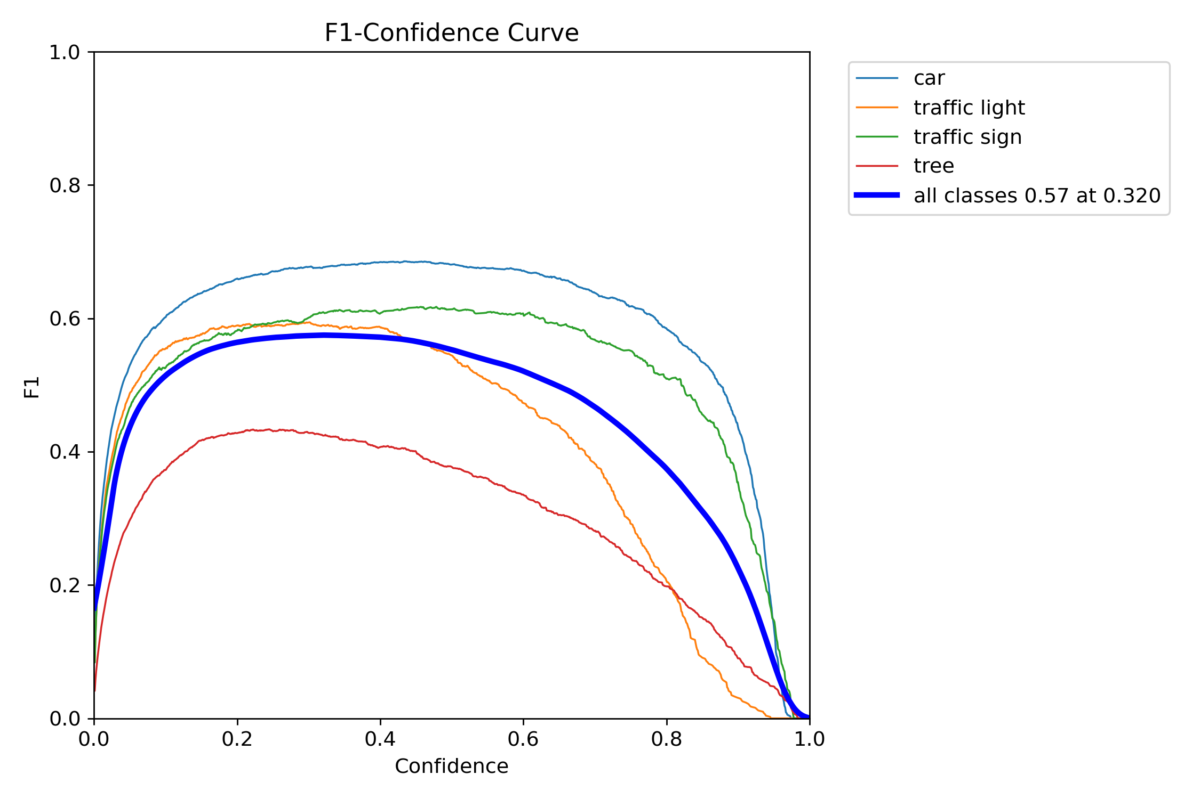
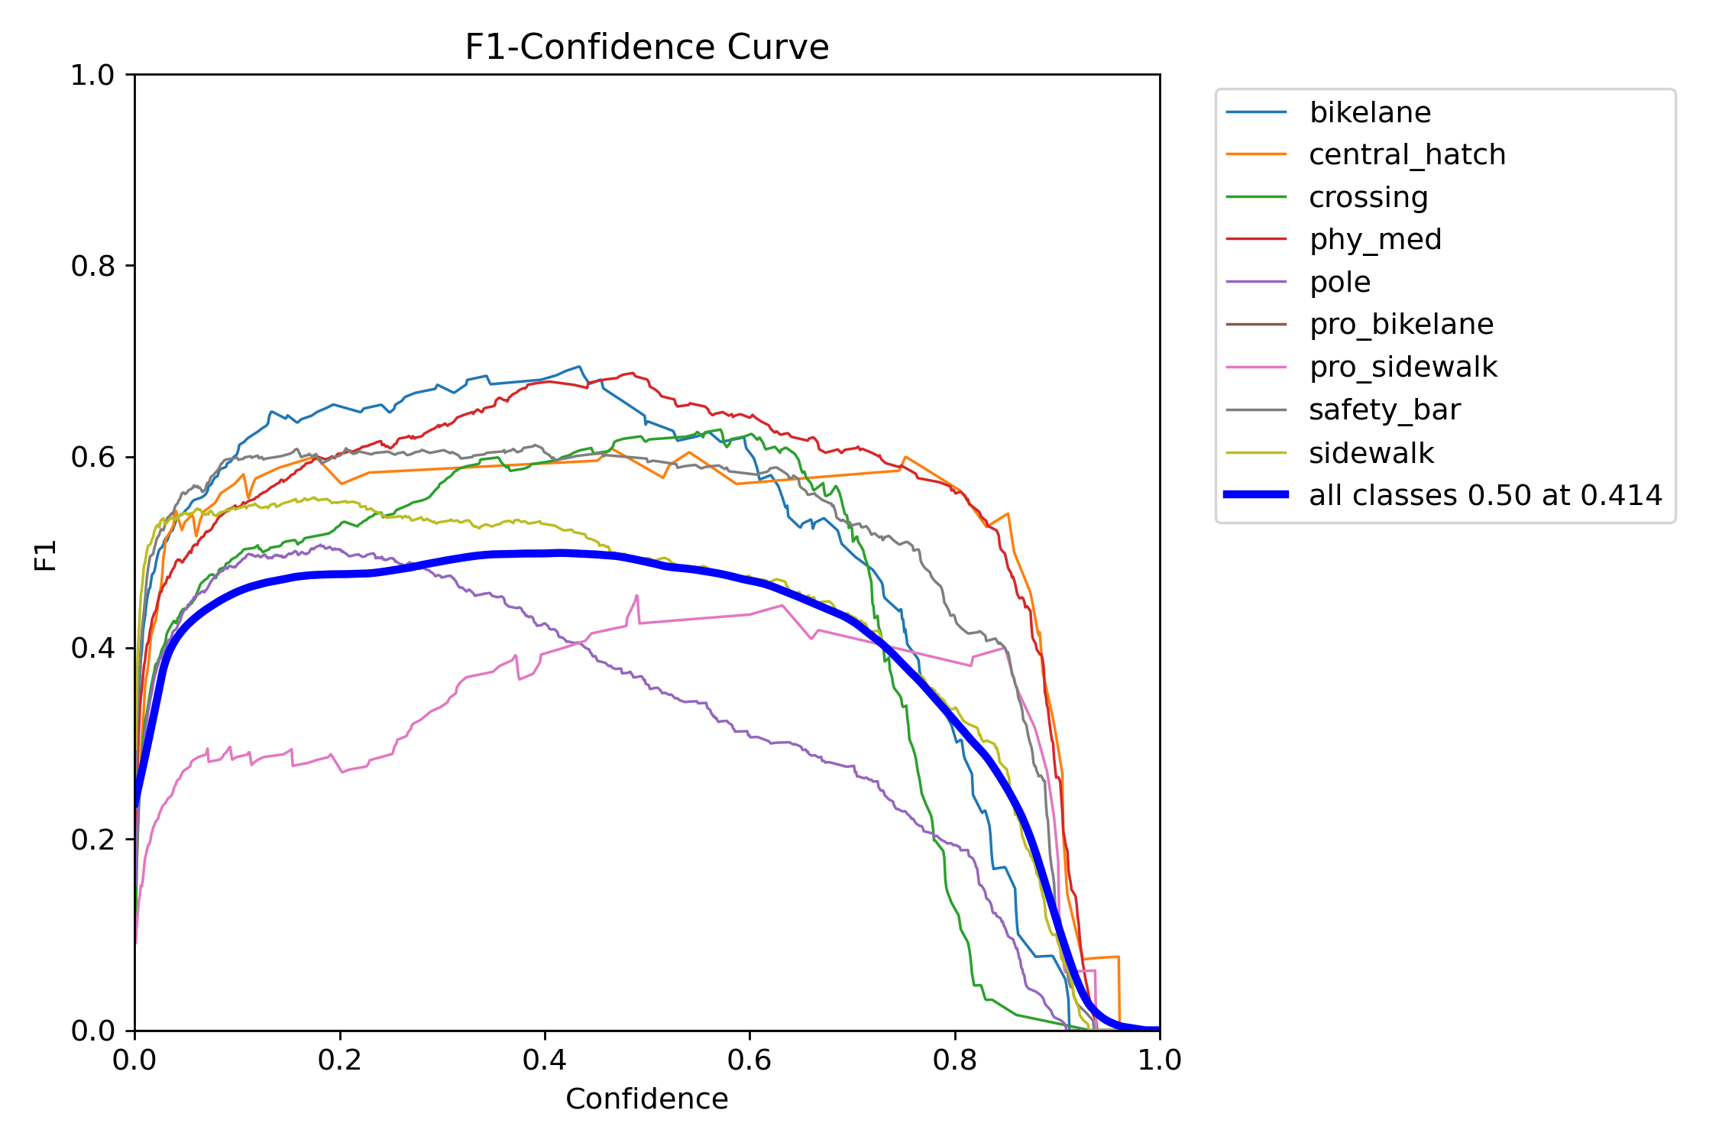
9. Appendices
Appendix 5. F1 Confidence curve for Layer 1_1
Appendix 6. F1 Confidence curve for Layer 1_2

Slide 22
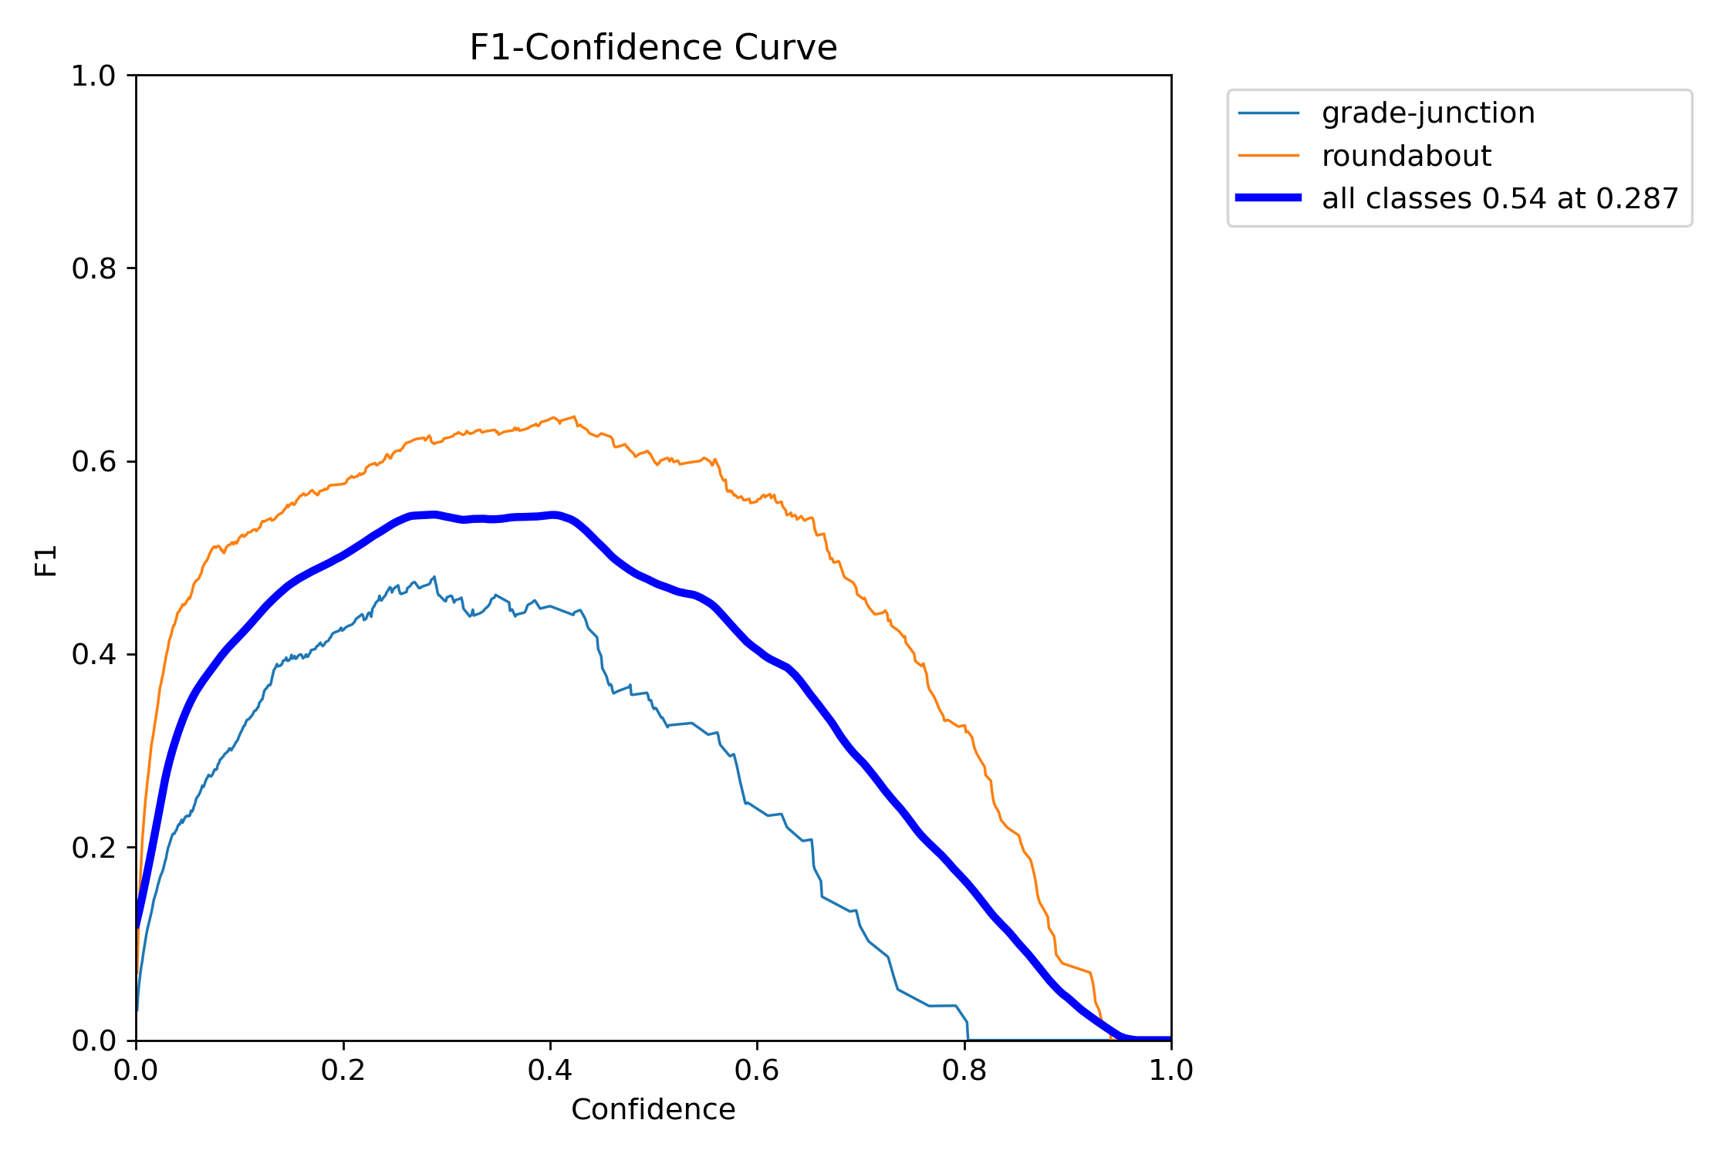
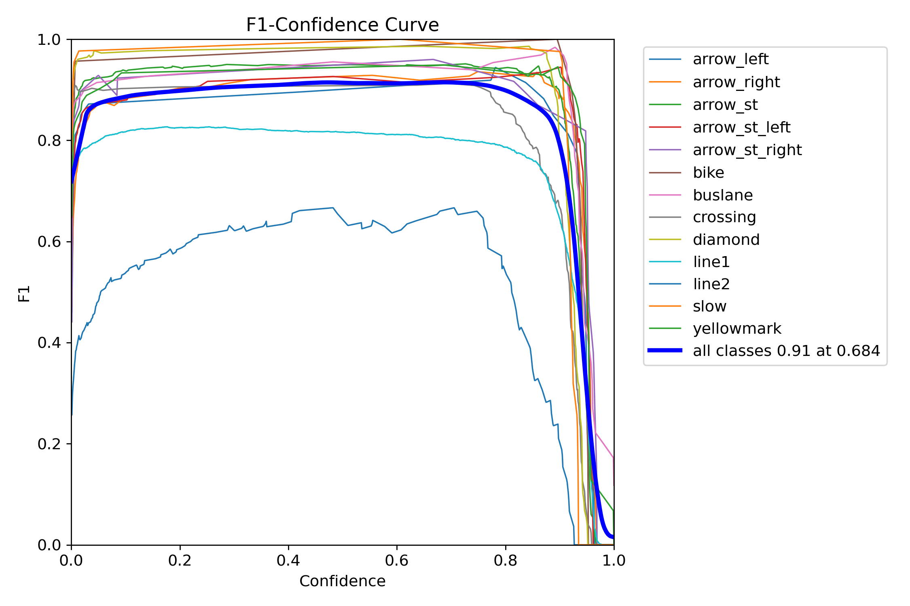
9. Appendices
Appendix 7. F1 Confidence curve for Layer 2
Appendix 8. F1 Confidence curve for Layer 3

Slide 23
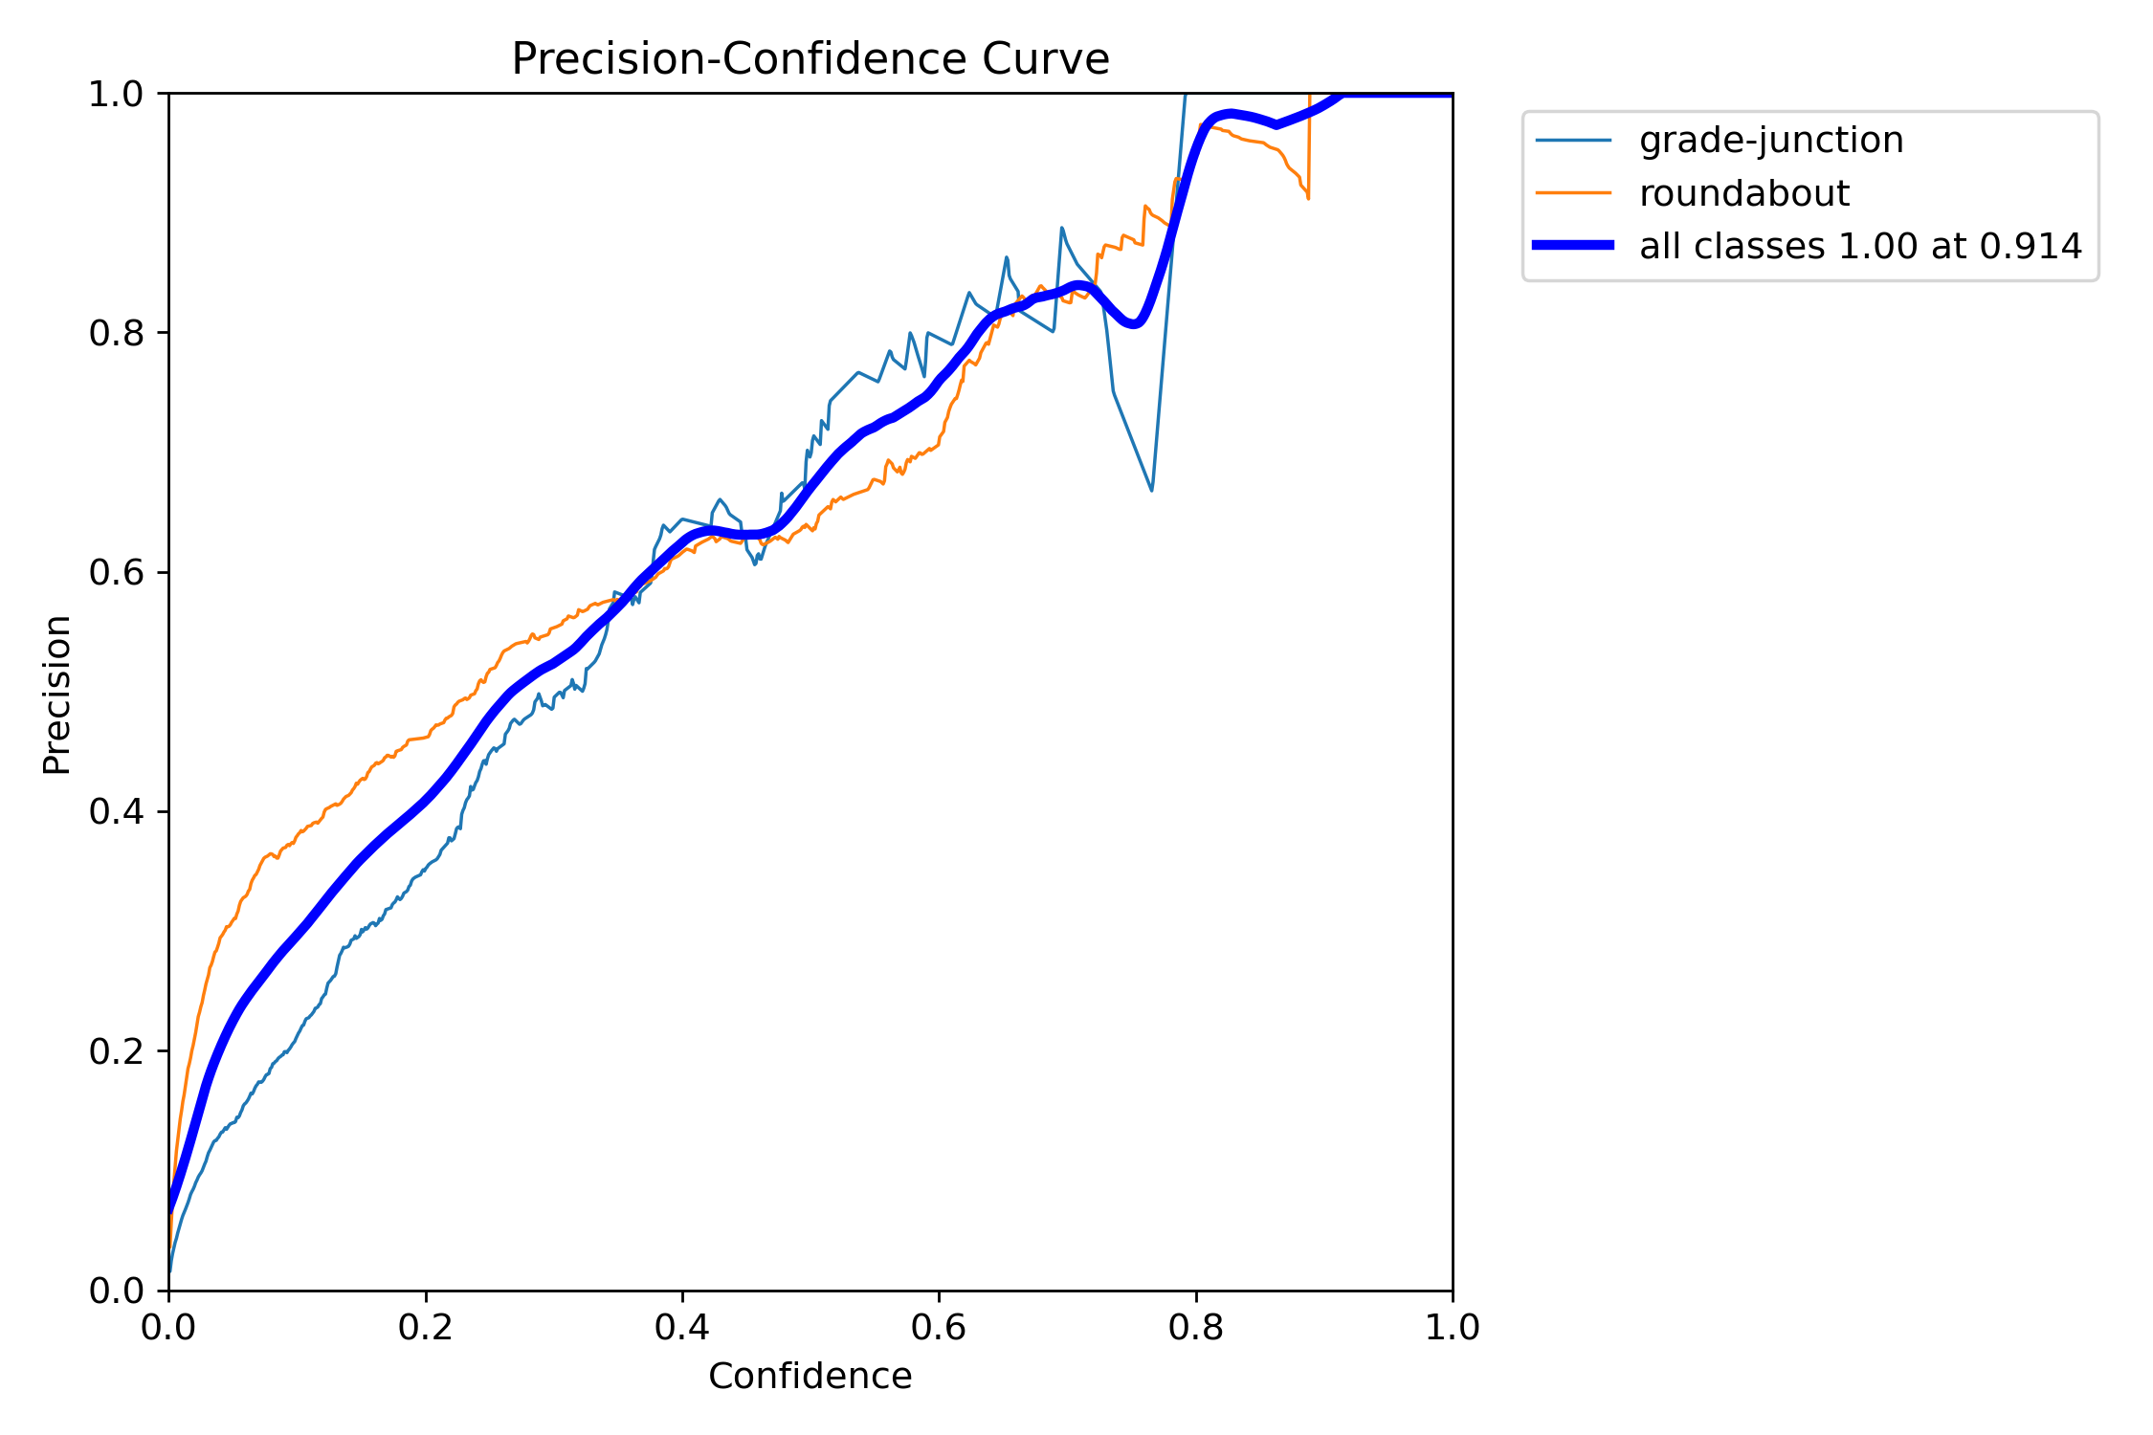
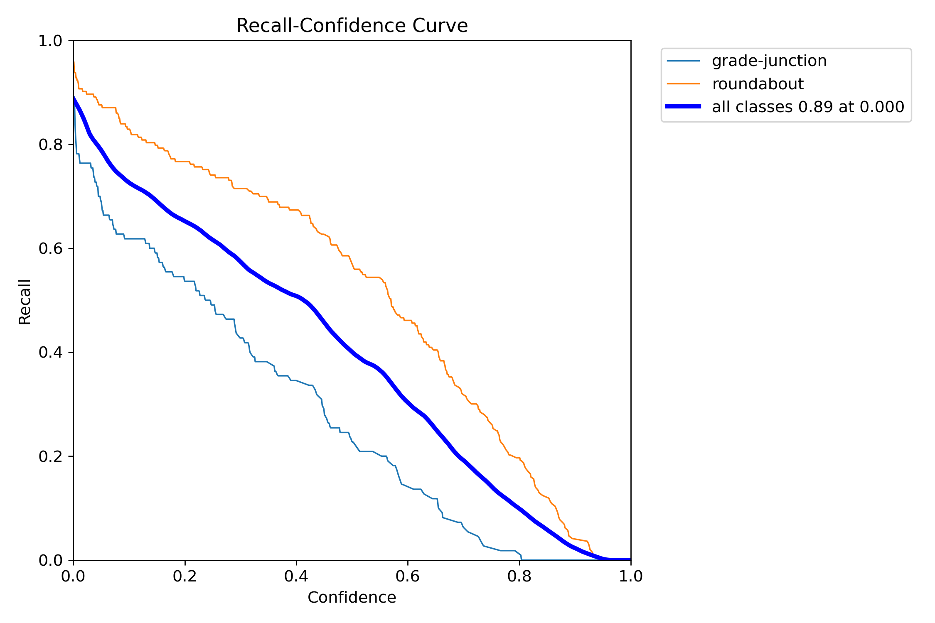
9. Appendices
Appendix 9. Precision – Confidence curve of Layer 2
Appendix 10. Recall – Confidence curve of Layer 2

Slide 24
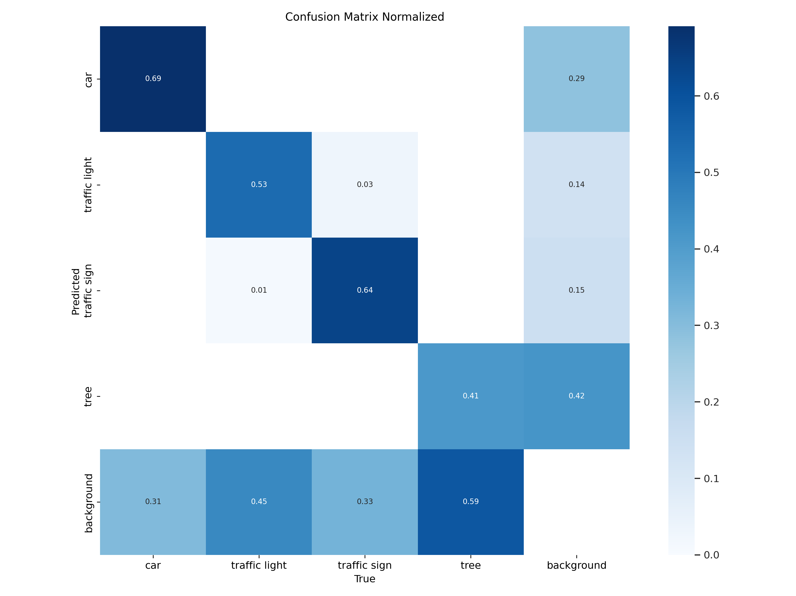
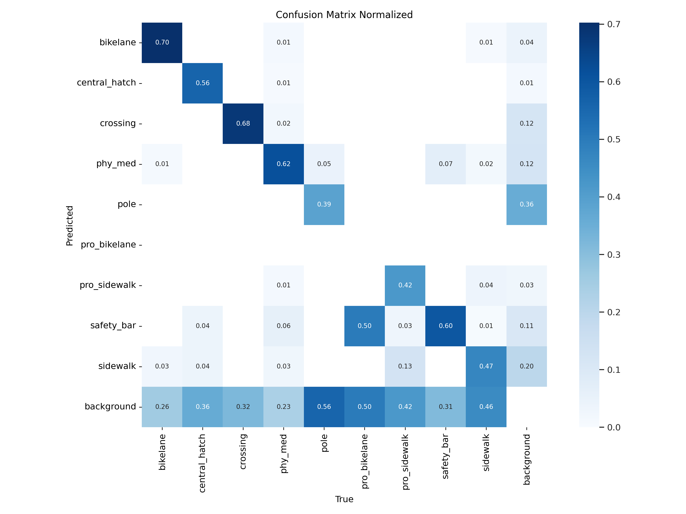
9. Appendices
Appendix 11. Normalised confusion matrix of Layer 1_1
Appendix 12. Normalised confusion matrix of Layer 1_2

Slide 25
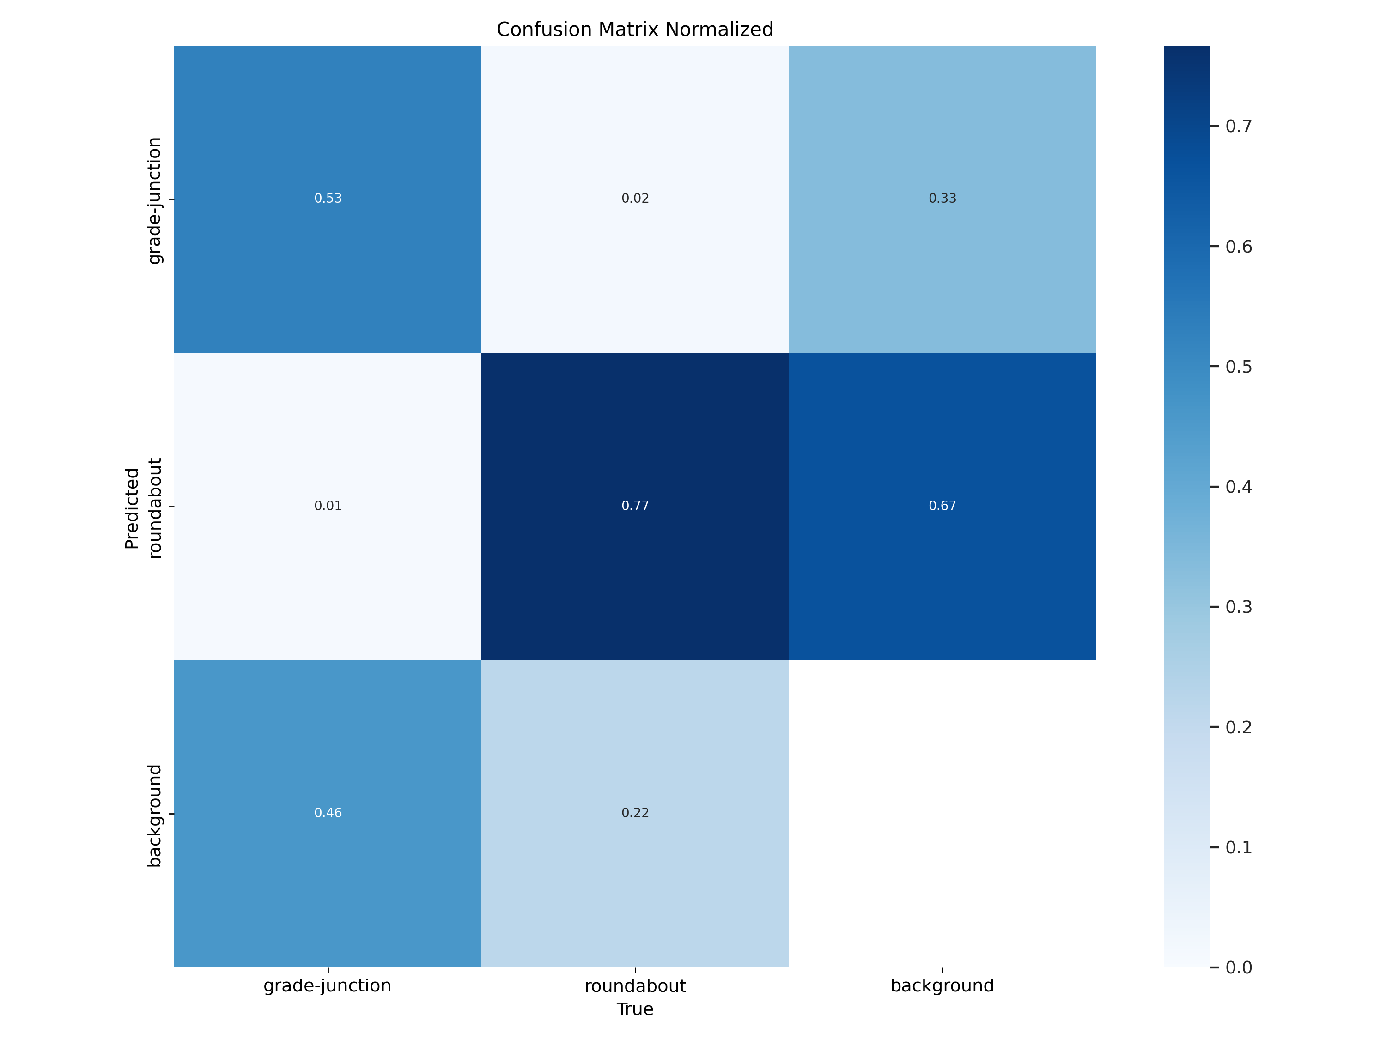
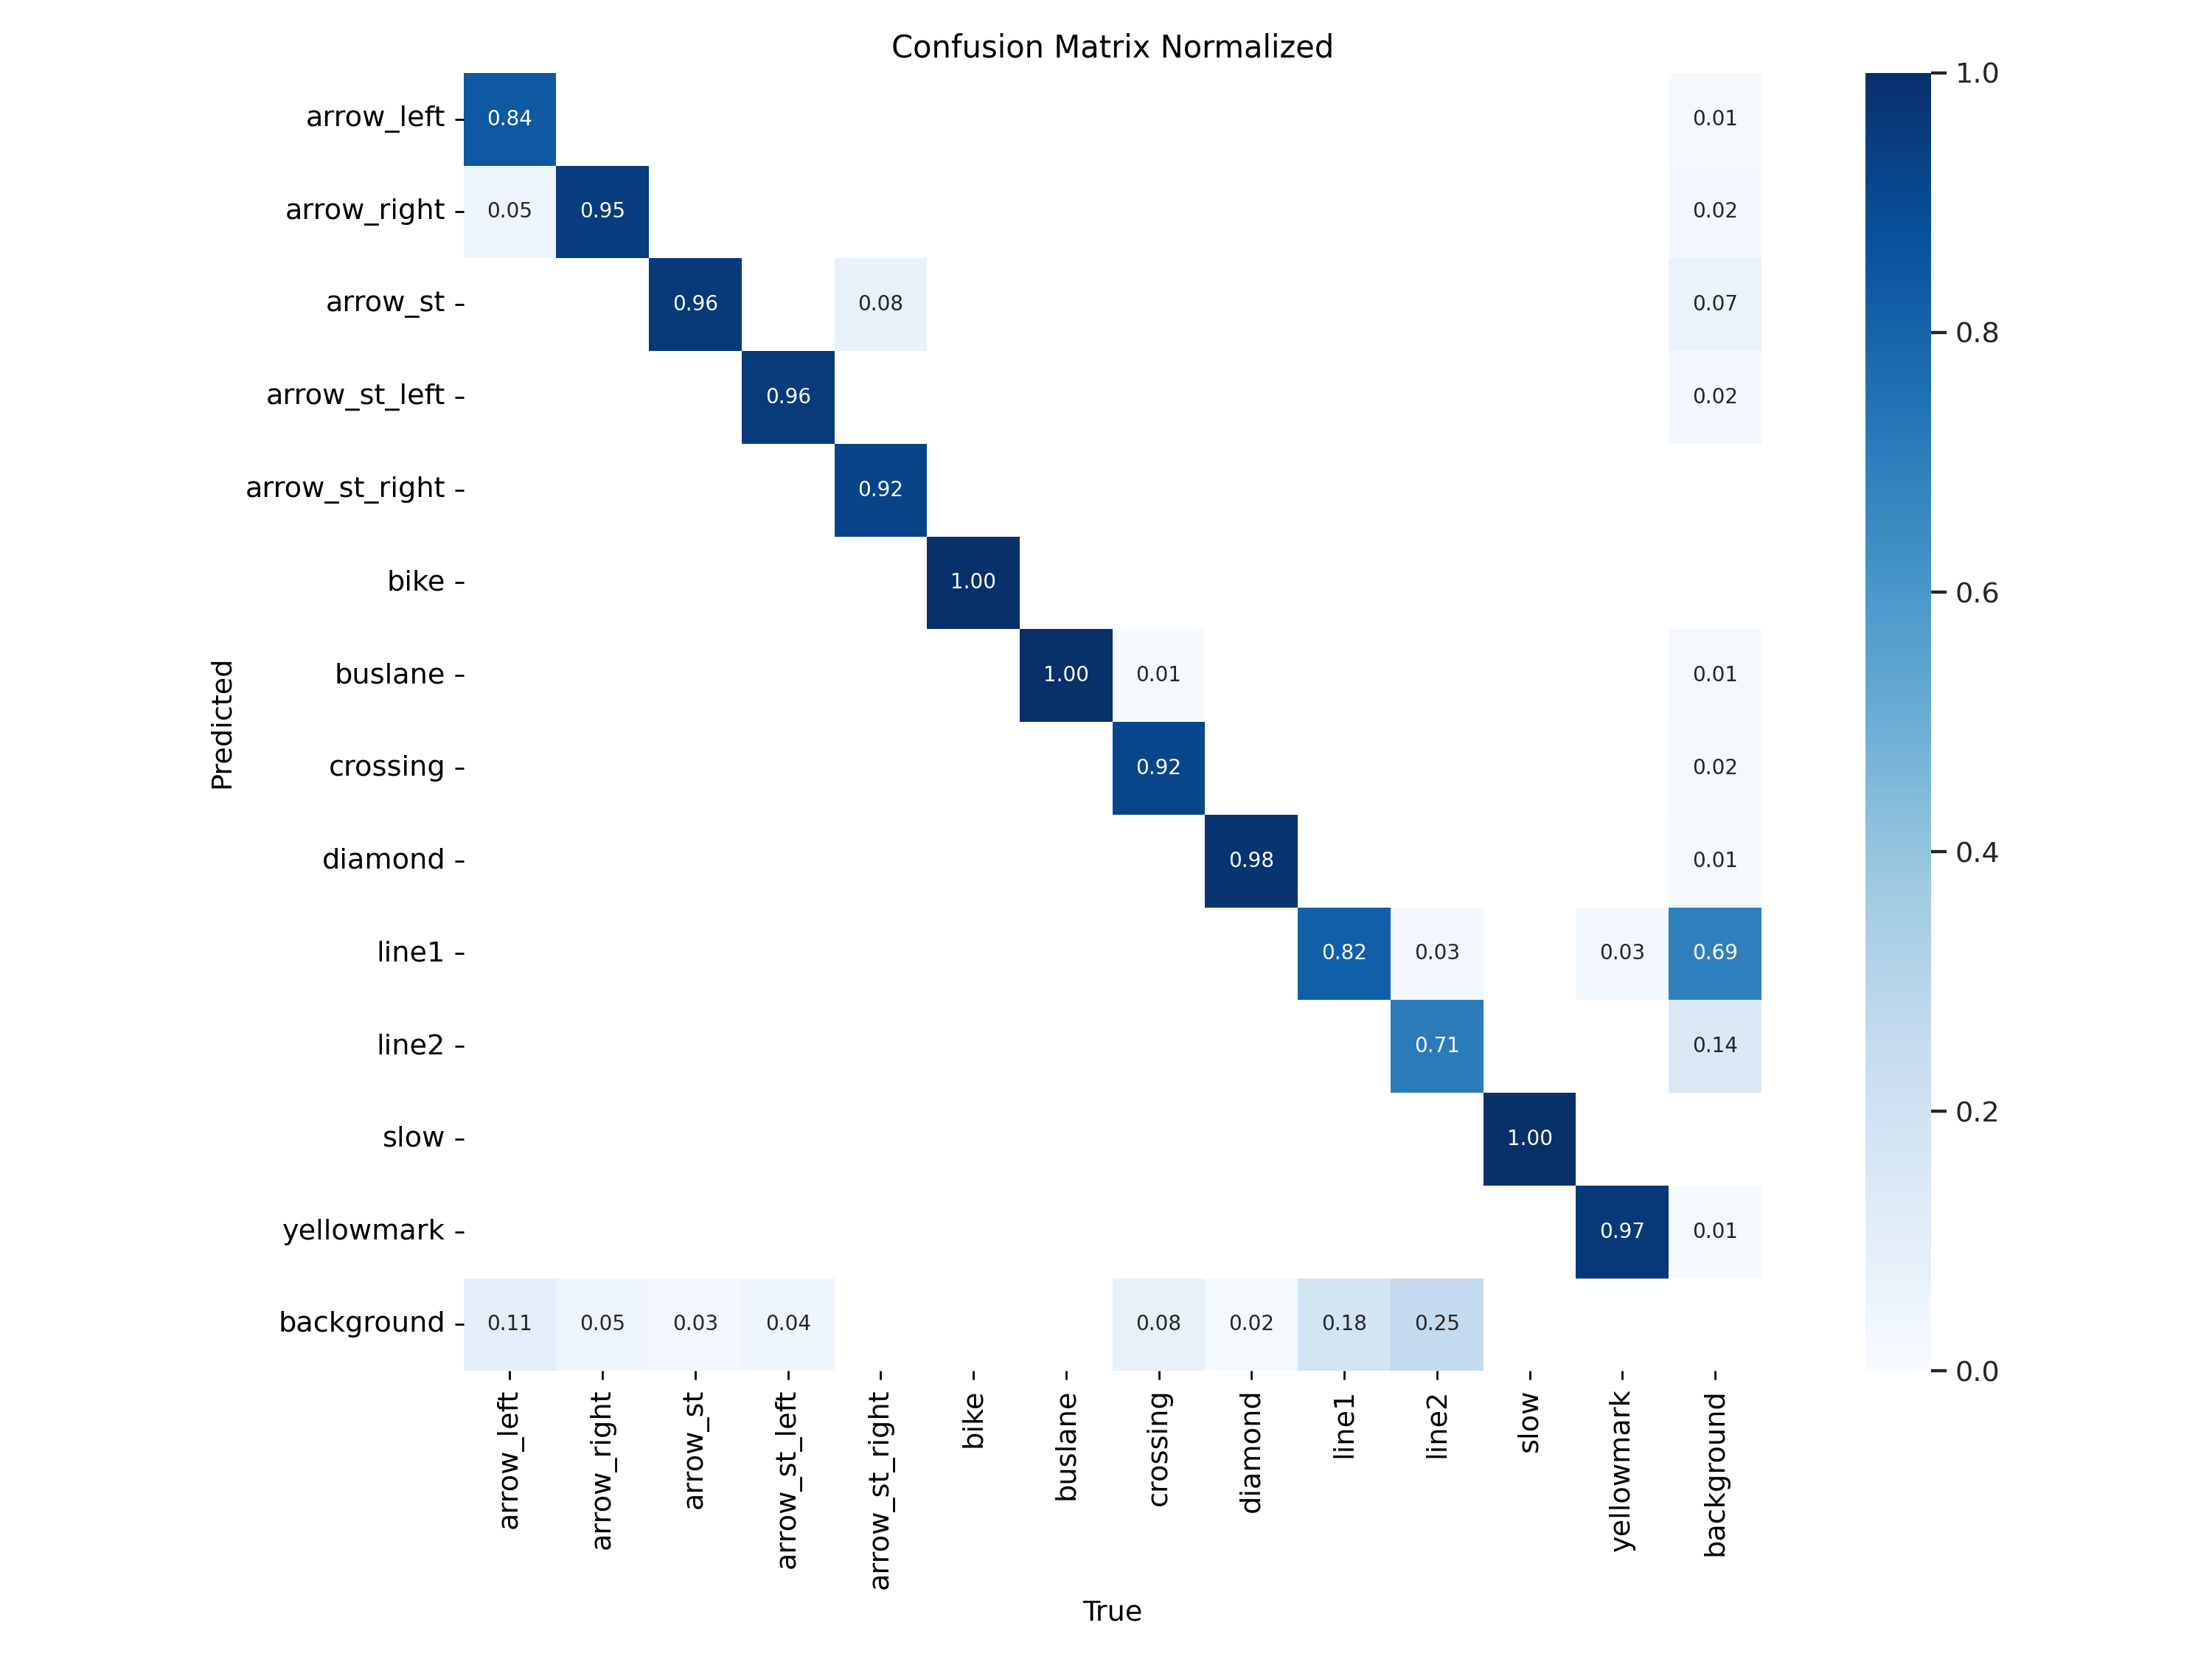
9. Appendices
Appendix 13. Normalised confusion matrix of Layer 2
Appendix 14. Normalised confusion matrix of Layer 3

Slide 26
Appendices
Class | Iteration 1 | Iteration 2 | Iteration 3 | Change in Accuracy Between 2nd & 3rd
Bike lane | 0.17 | 0.57 | 0.70 | +0.13
Central hatch | 0.60 | 0.36 | 0.56 | +0.20
Crossing | 0.70 | 0.54 | 0.68 | +0.12
Physical medium | 0.62 | 0.47 | 0.62 | +0.15
Pole | 0.42 | 0.23 | 0.39 | +0.16
Protected sidewalk | 0.61 | 0.23 | 0.42 | +0.19
Sidewalk | 0.50 | 0.30 | 0.47 | +0.17
Appendix 14. True positive proportion of each class for every iteration of model 2

Slide 27
Appendices
 |  | Sensitivity | Specificity | NPV | Precision | Occurrences
Model 1 | car | 0.6911 | 0.9182 | 0.9055 | 0.7237 | 1444
 | traffic light | 0.5333 | 0.9603 | 0.9123 | 0.7267 | 1007
 | traffic sign | 0.6389 | 0.9616 | 0.9656 | 0.6123 | 529
 | tree | 0.4125 | 0.8705 | 0.7799 | 0.5712 | 1799
Model 2 | bikelane | 0.7027 | 0.9869 | 0.9889 | 0.6667 | 74
 | central_hatch | 0.5600 | 0.9961 | 0.9946 | 0.6364 | 25
 | crossing | 0.6803 | 0.9684 | 0.9796 | 0.5764 | 122
 | phy_med | 0.6168 | 0.9434 | 0.9549 | 0.5593 | 214
 | pole | 0.3879 | 0.8941 | 0.7877 | 0.5906 | 580
 | pro_bikelane | 0.0000 | 0.9985 | 0.9990 | 0.0000 | 2
 | pro_sidewalk | 0.4194 | 0.9862 | 0.9911 | 0.3171 | 31
 | safety_bar | 0.5972 | 0.9646 | 0.9532 | 0.6649 | 216
 | sidewalk | 0.4718 | 0.9400 | 0.8952 | 0.6208 | 354
Model 3 | grade-junction | 0.5273 | 0.8746 | 0.8323 | 0.6105 | 110
 | roundabout | 0.7668 | 0.6745 | 0.7606 | 0.6820 | 193
Model 4 | arrow_left | 0.8333 | 0.9986 | 0.9986 | 0.8333 | 18
 | arrow_right | 0.9455 | 0.9968 | 0.9986 | 0.8814 | 55
 | arrow_st | 0.9605 | 0.9914 | 0.9954 | 0.9280 | 228
 | arrow_st_left | 0.9565 | 0.9972 | 0.9991 | 0.8800 | 46
 | arrow_st_right | 0.9231 | 1.0000 | 0.9995 | 1.0000 | 13
 | bike | 1.0000 | 1.0000 | 1.0000 | 1.0000 | 11
 | buslane | 1.0000 | 0.9982 | 1.0000 | 0.8889 | 32
 | crossing | 0.9167 | 0.9981 | 0.9947 | 0.9680 | 132
 | diamond | 0.9817 | 0.9990 | 0.9990 | 0.9817 | 109
 | line1 | 0.8177 | 0.8257 | 0.7885 | 0.8506 | 1212
 | line2 | 0.7119 | 0.9837 | 0.9920 | 0.5455 | 59
 | slow | 1.0000 | 1.0000 | 1.0000 | 1.0000 | 21
 | yellowmark | 0.9655 | 0.9991 | 0.9995 | 0.9333 | 29
Appendix 15. Detection metrics for model benchmarking

